Slide 1
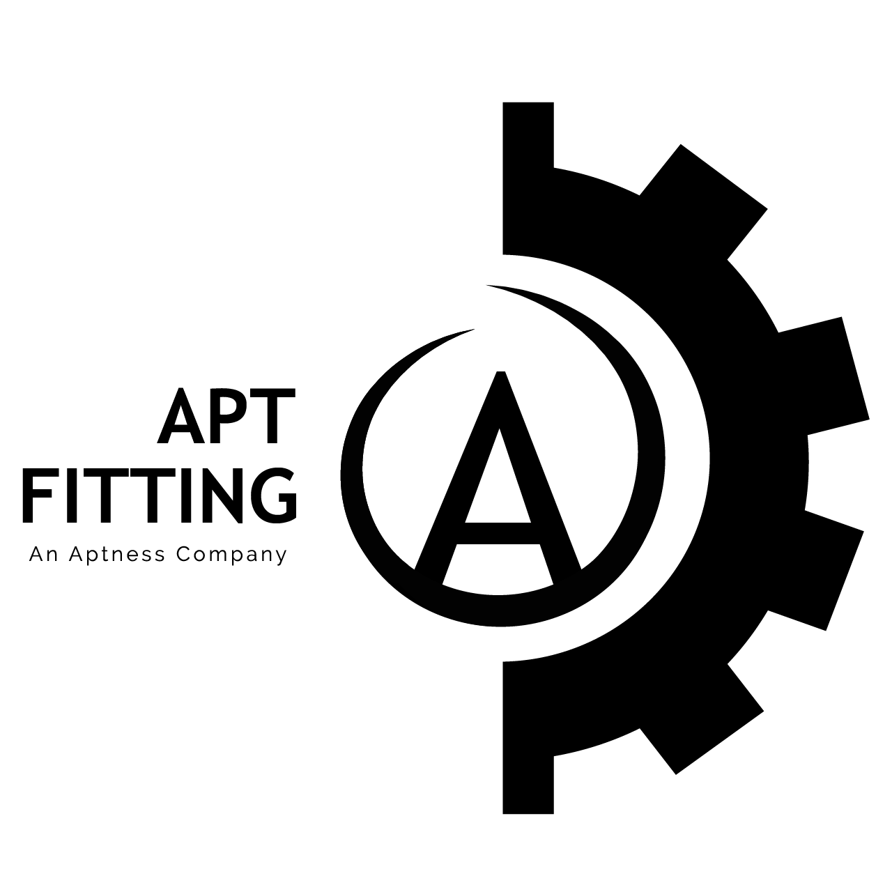
Business Expansion PROPOSAL for Apt Fitting- FINAL PROJECT
Regis University - MSDS696 - Data Science Practicum II
Instructor: Ksenia Polson
Lizbeth Bolano

Slide 2
Contents
Problem or Situation
Research Question
Data
Proposed Methodology
Data Analysis
Conclusions

Slide 3
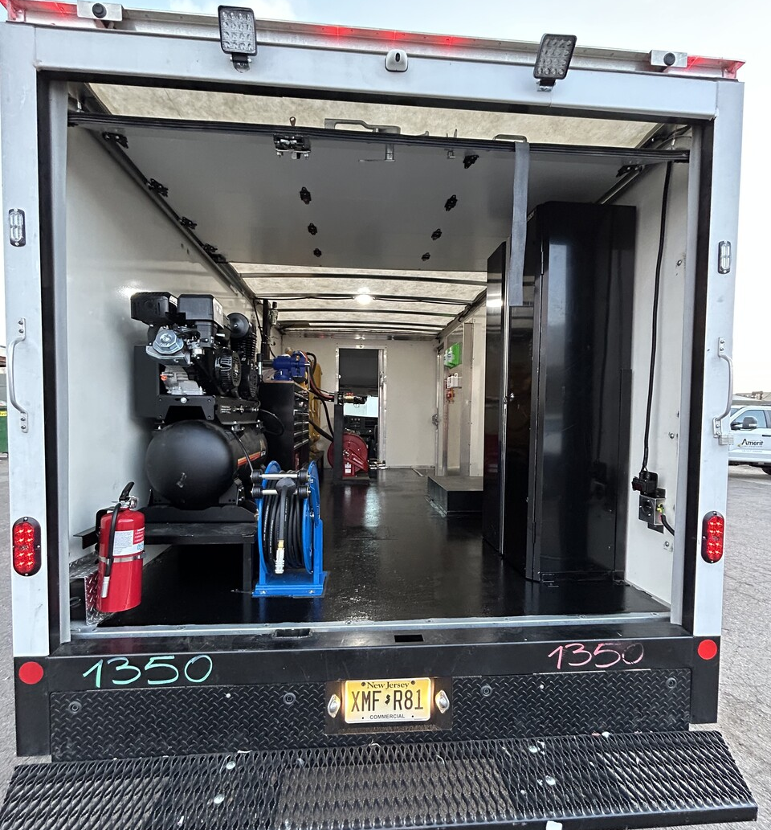
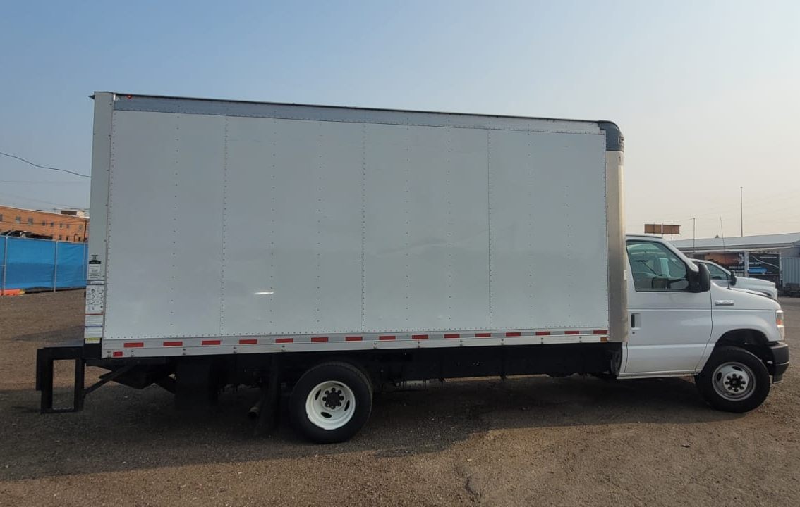
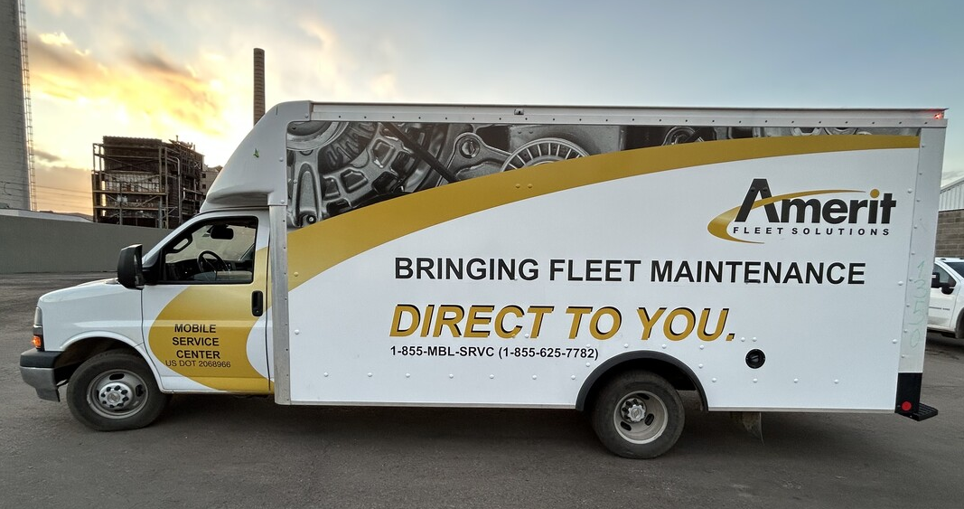
Problem / situation
Aptness Inc. has provided tailored business solutions with a focus on efficiency and attention to detail since 2019.
Its Apt Fitting division specializes in high-quality vehicle Upfits, enhancing functionality, efficiency, and safety. Currently, Apt Fitting serves Amerit, customizing mobile mechanic trucks for fleet maintenance.
This dependence on a single client poses a revenue risk, as changes in Amerit’s needs or market conditions could impact stability. Exploring Apt Fitting’s profitability and market expansion opportunities is key to diversifying its customer base and ensuring long-term growth.
Upfit: Installation of commercial vehicle accessories to meet the specific needs
of the owner.

Slide 4
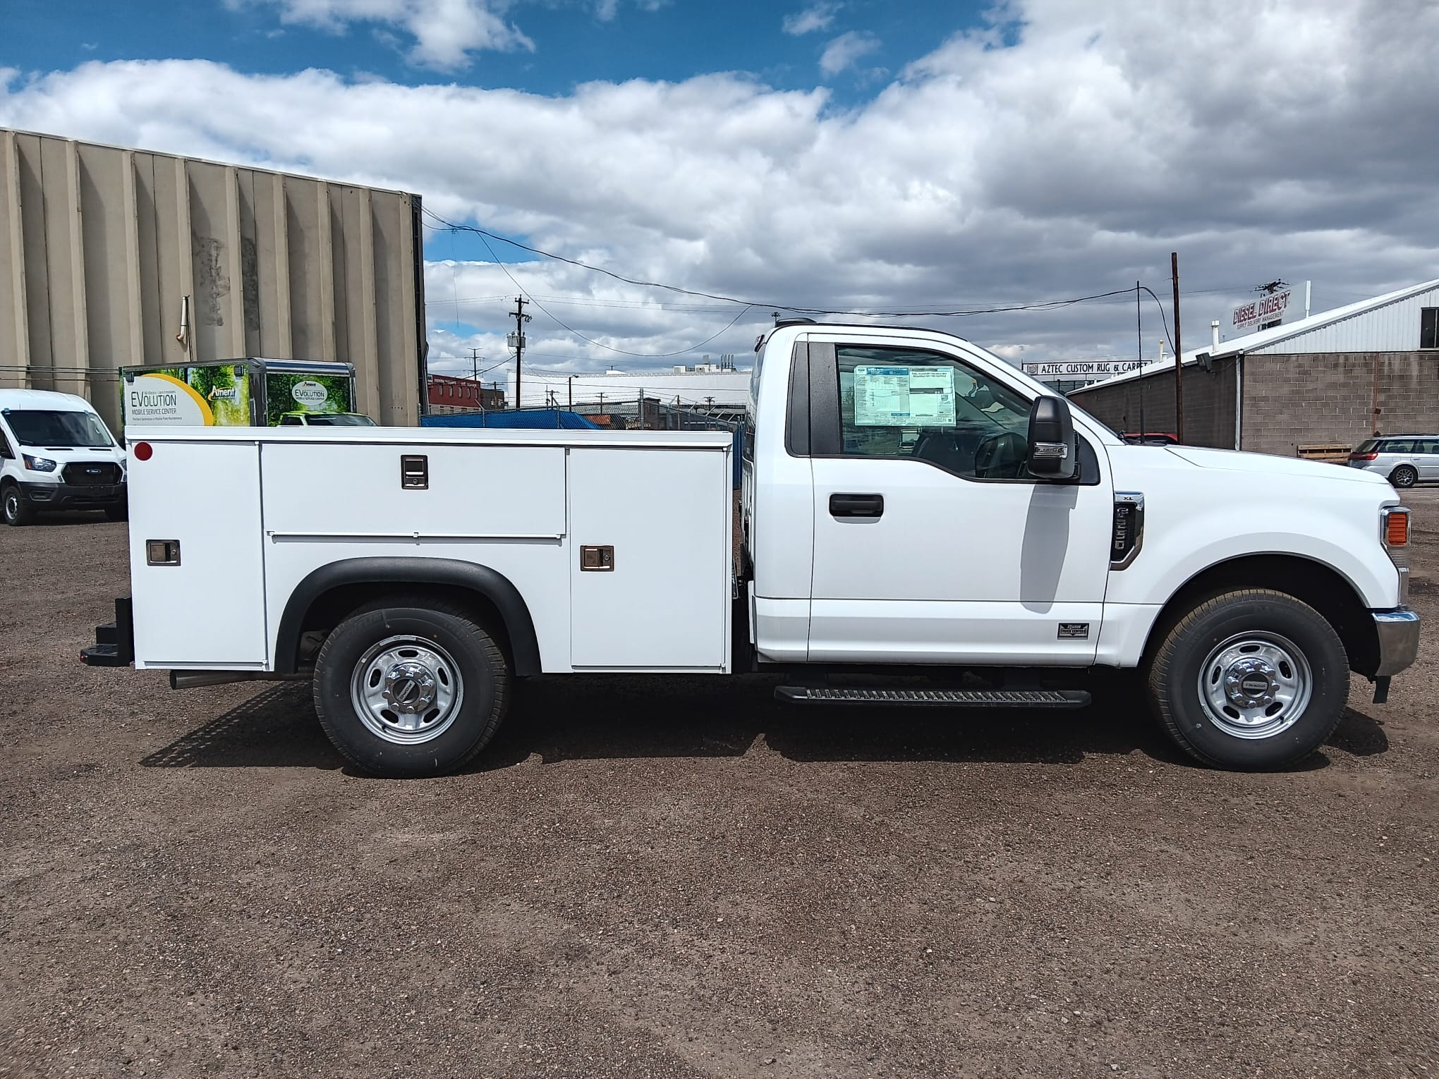
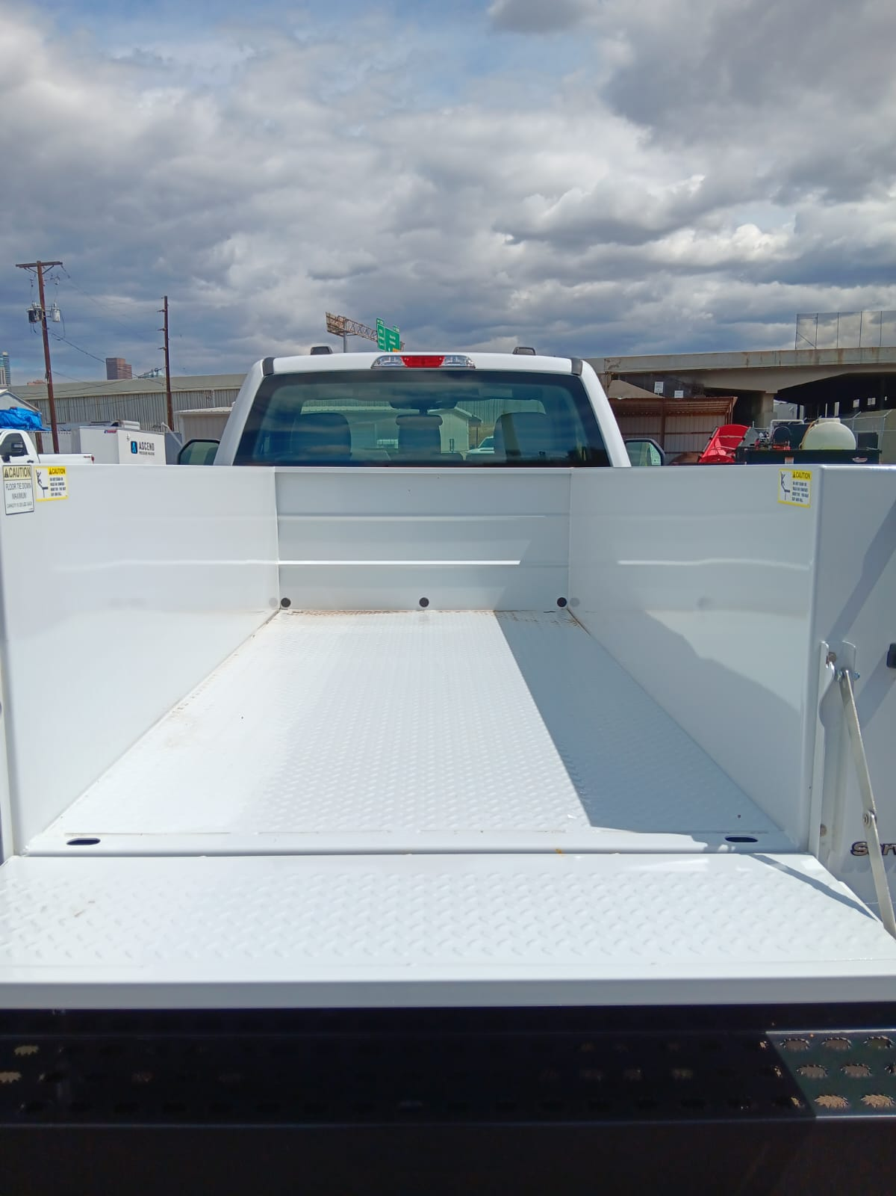
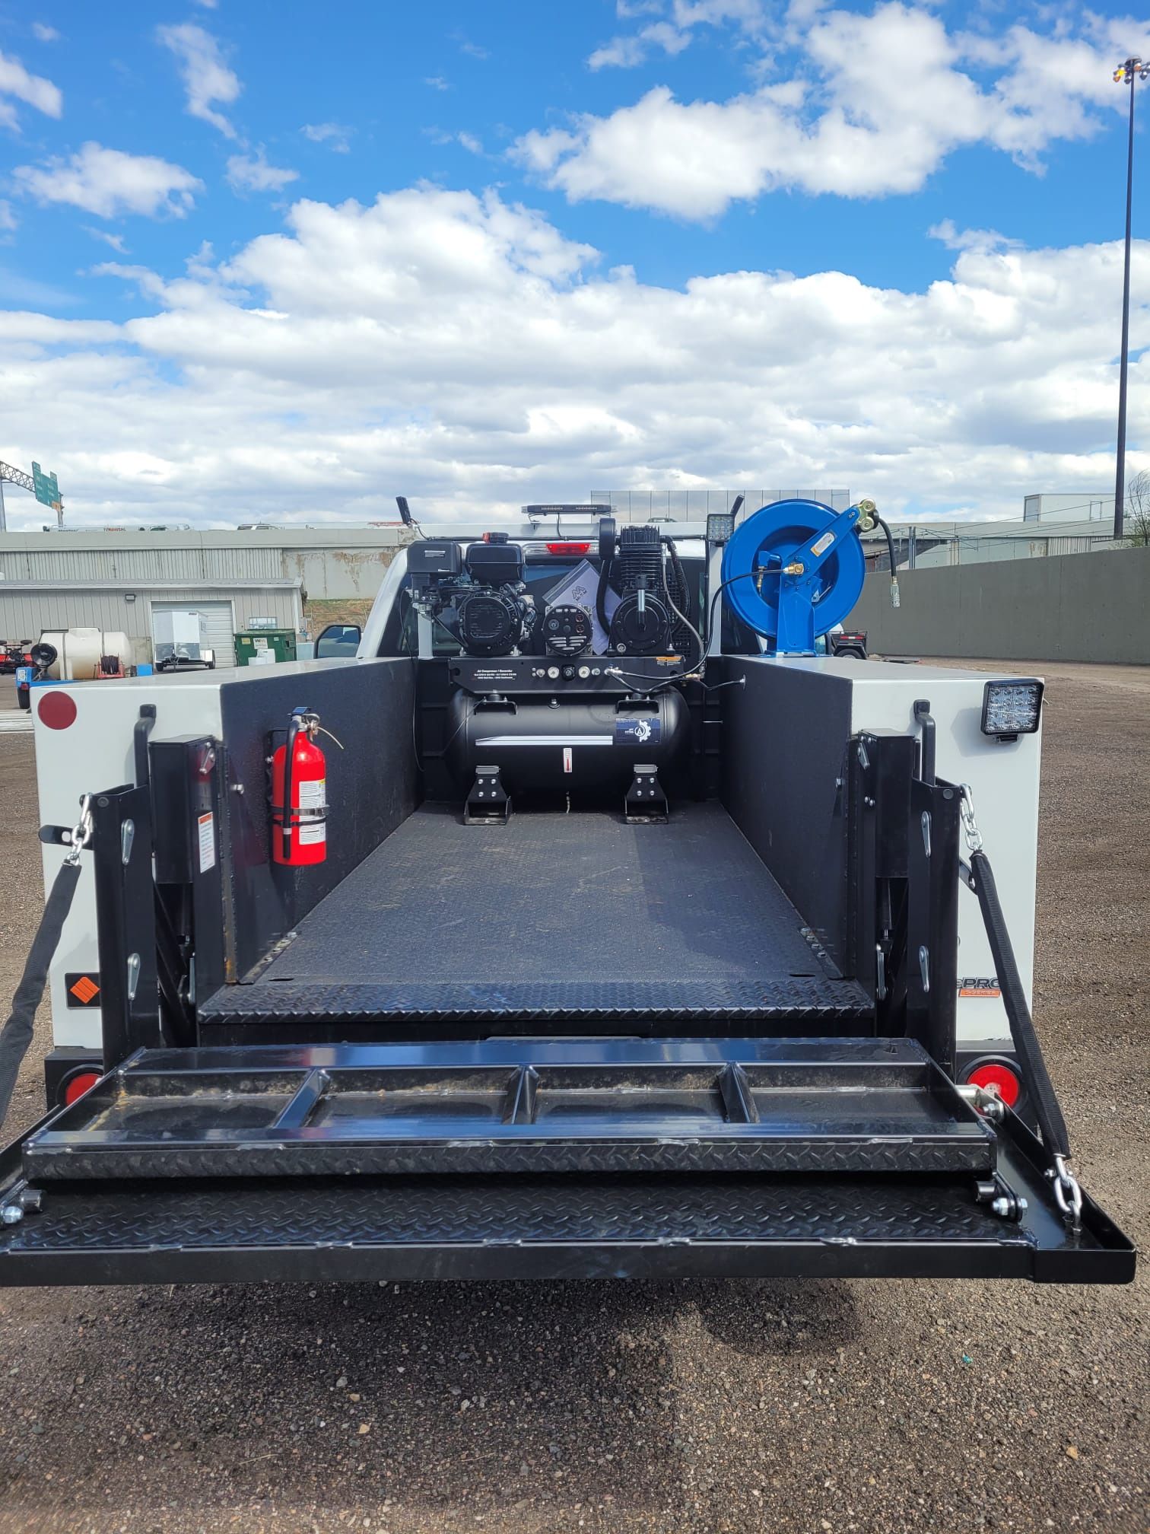
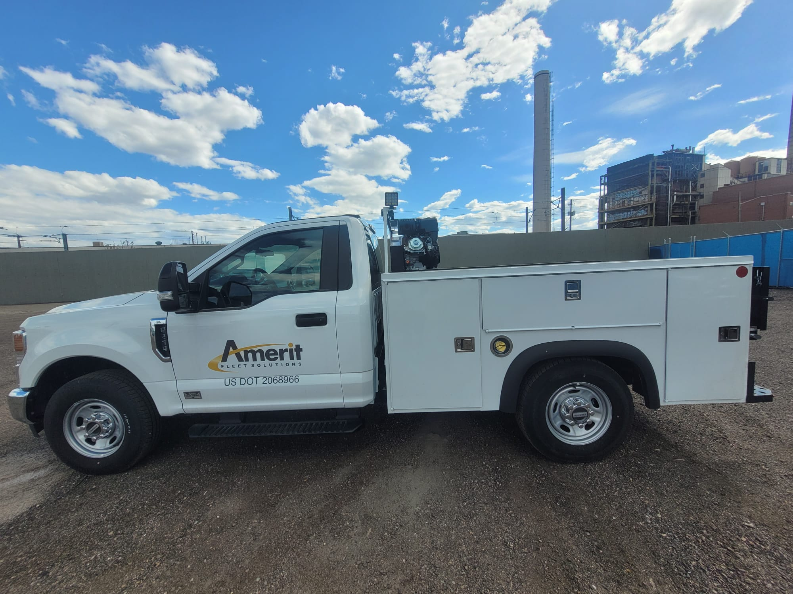
Type of units
U-Body

Slide 5
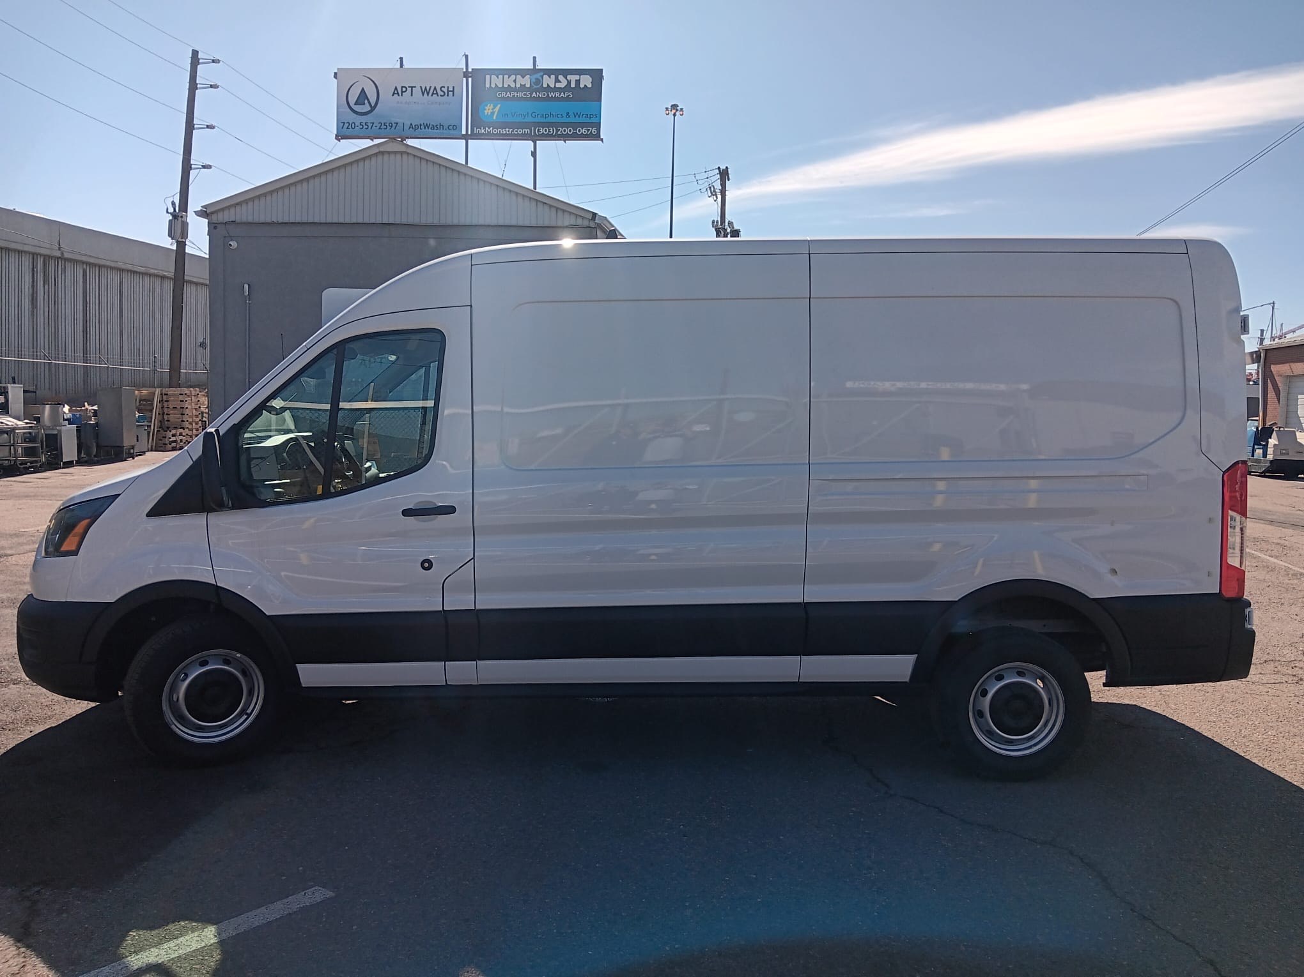
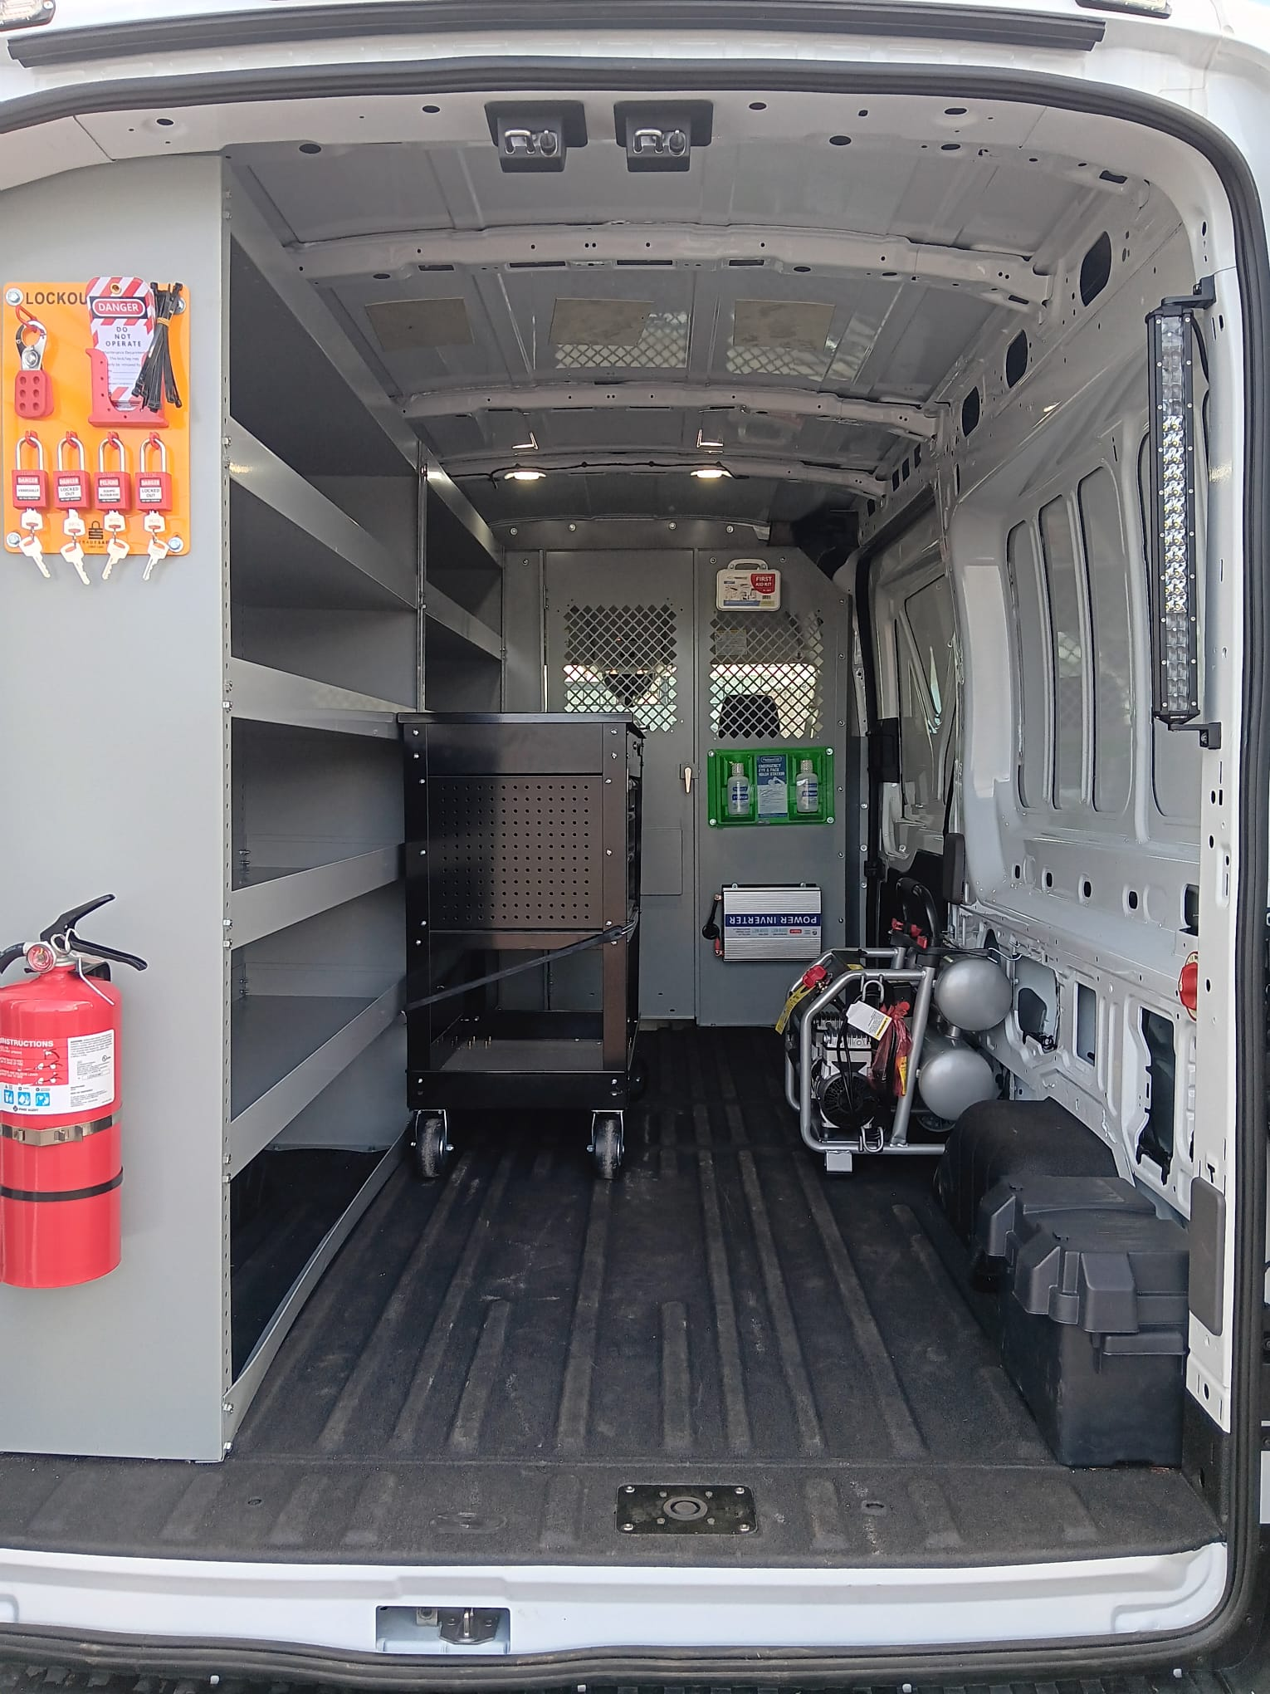
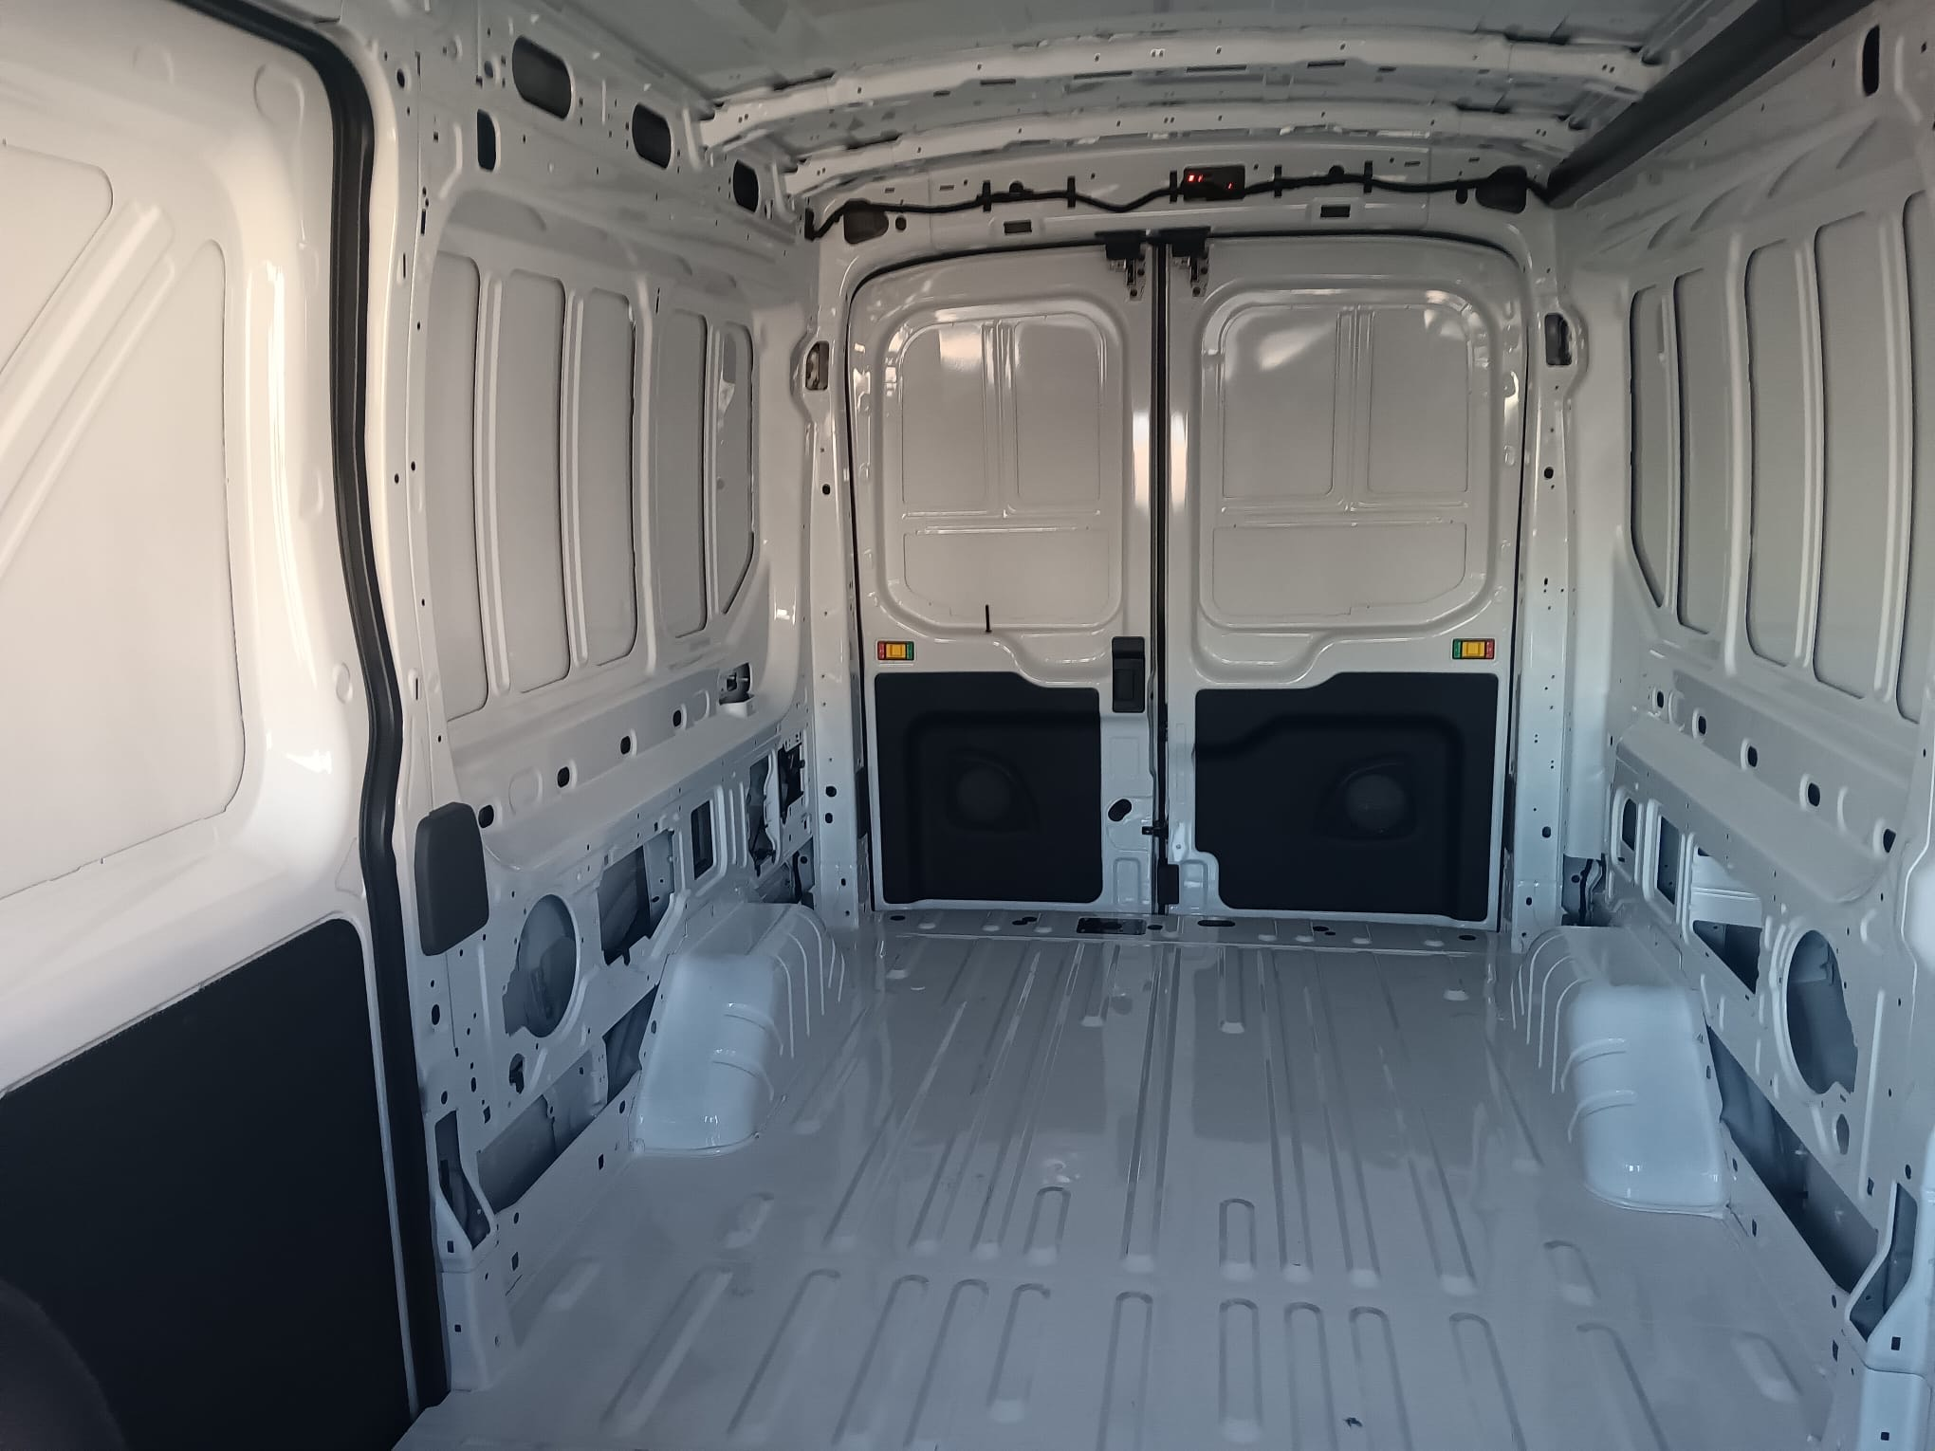
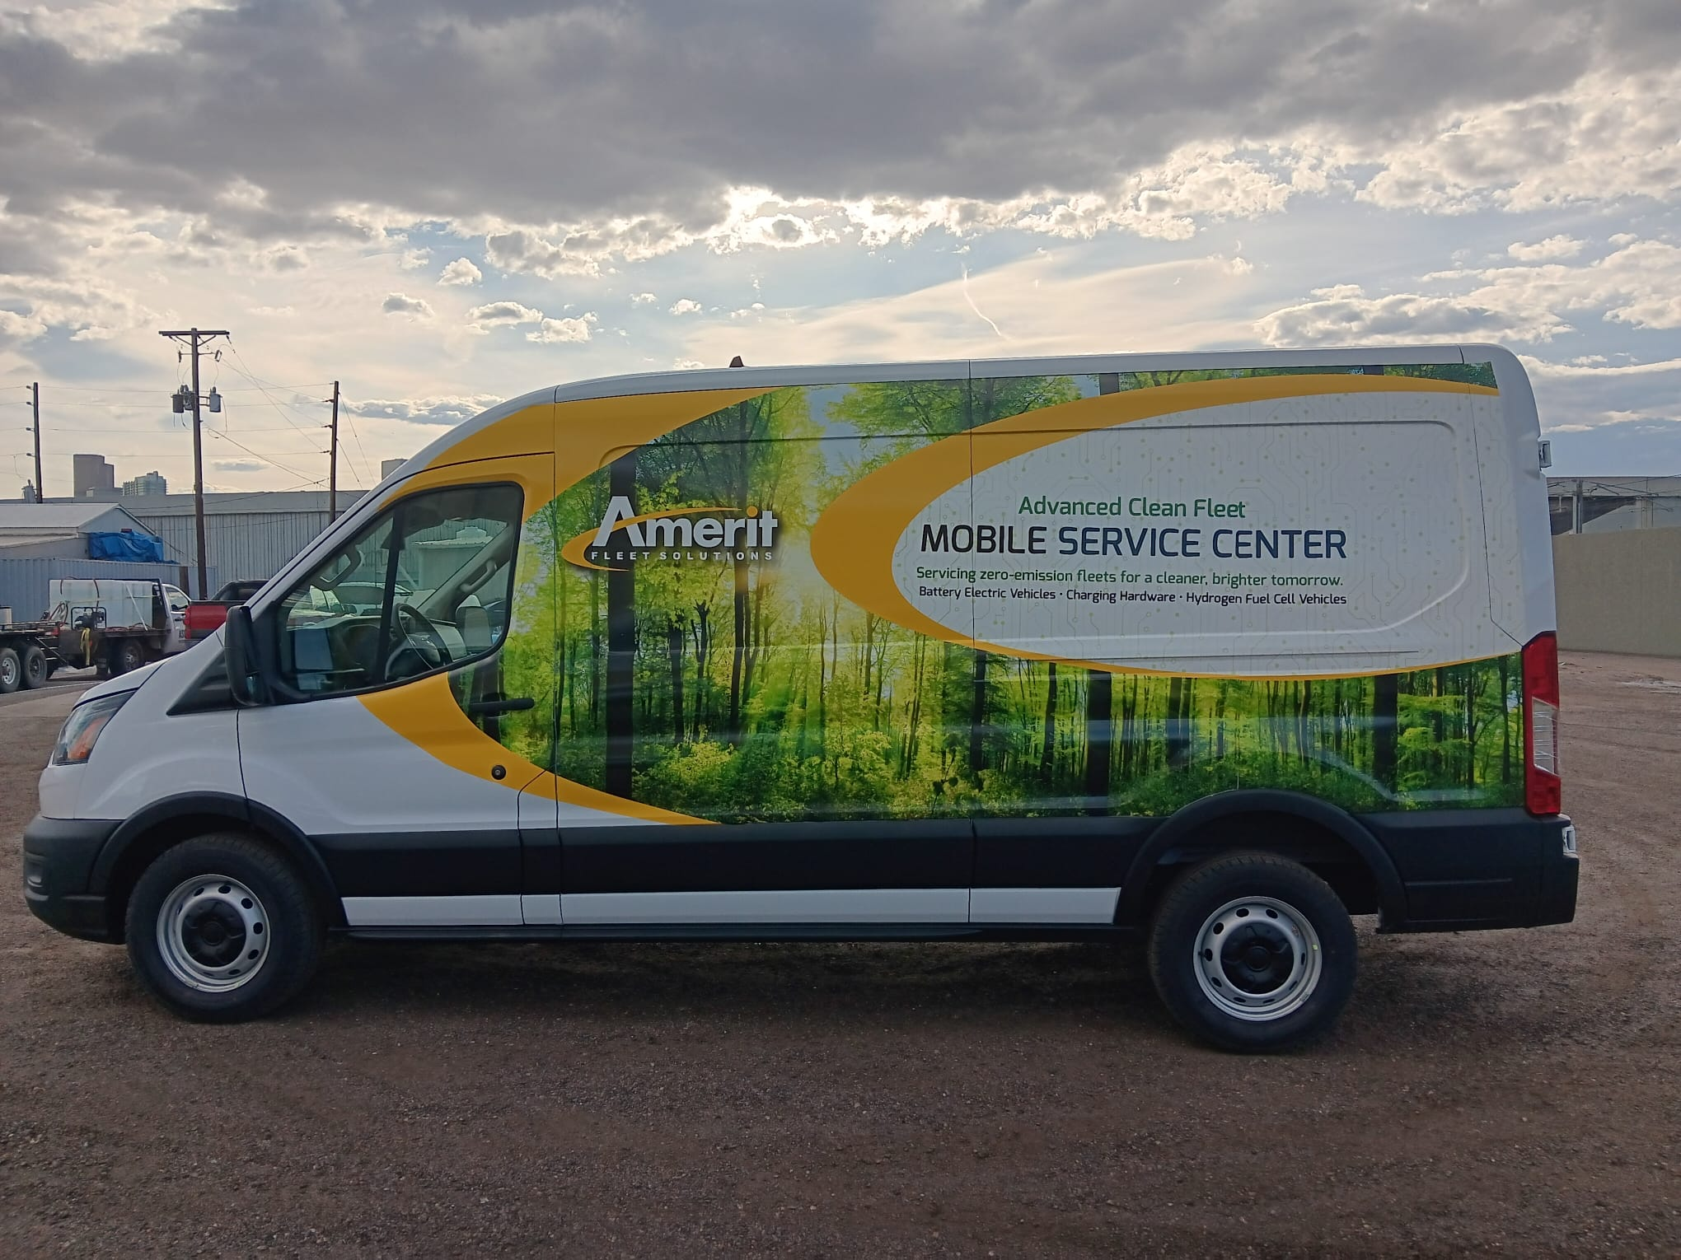
Transit ev

Slide 6
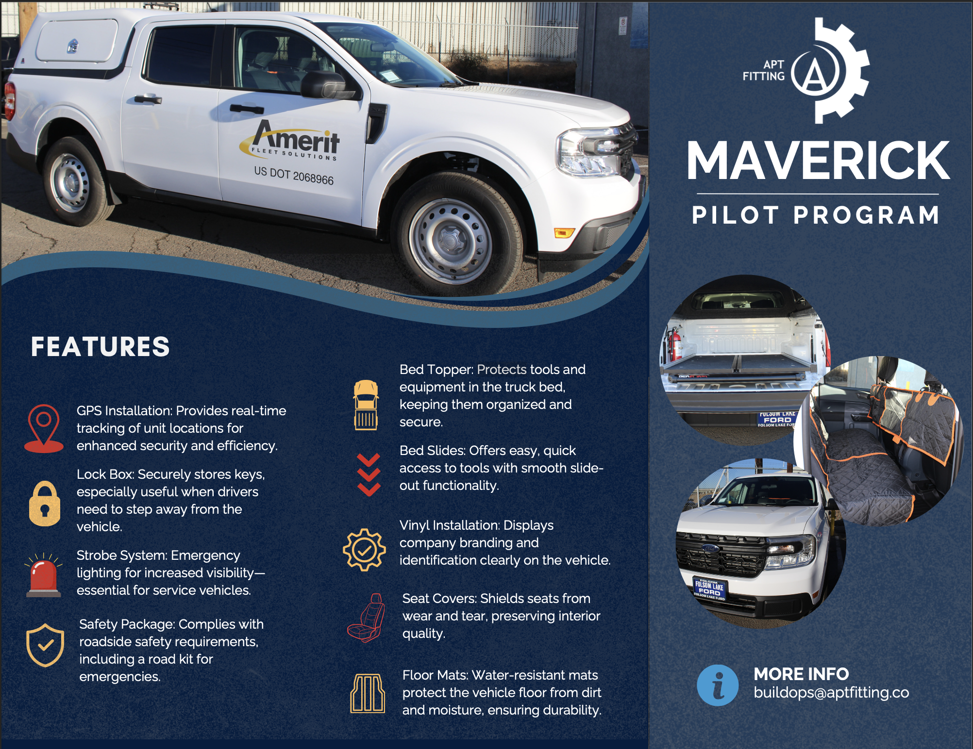

Slide 7
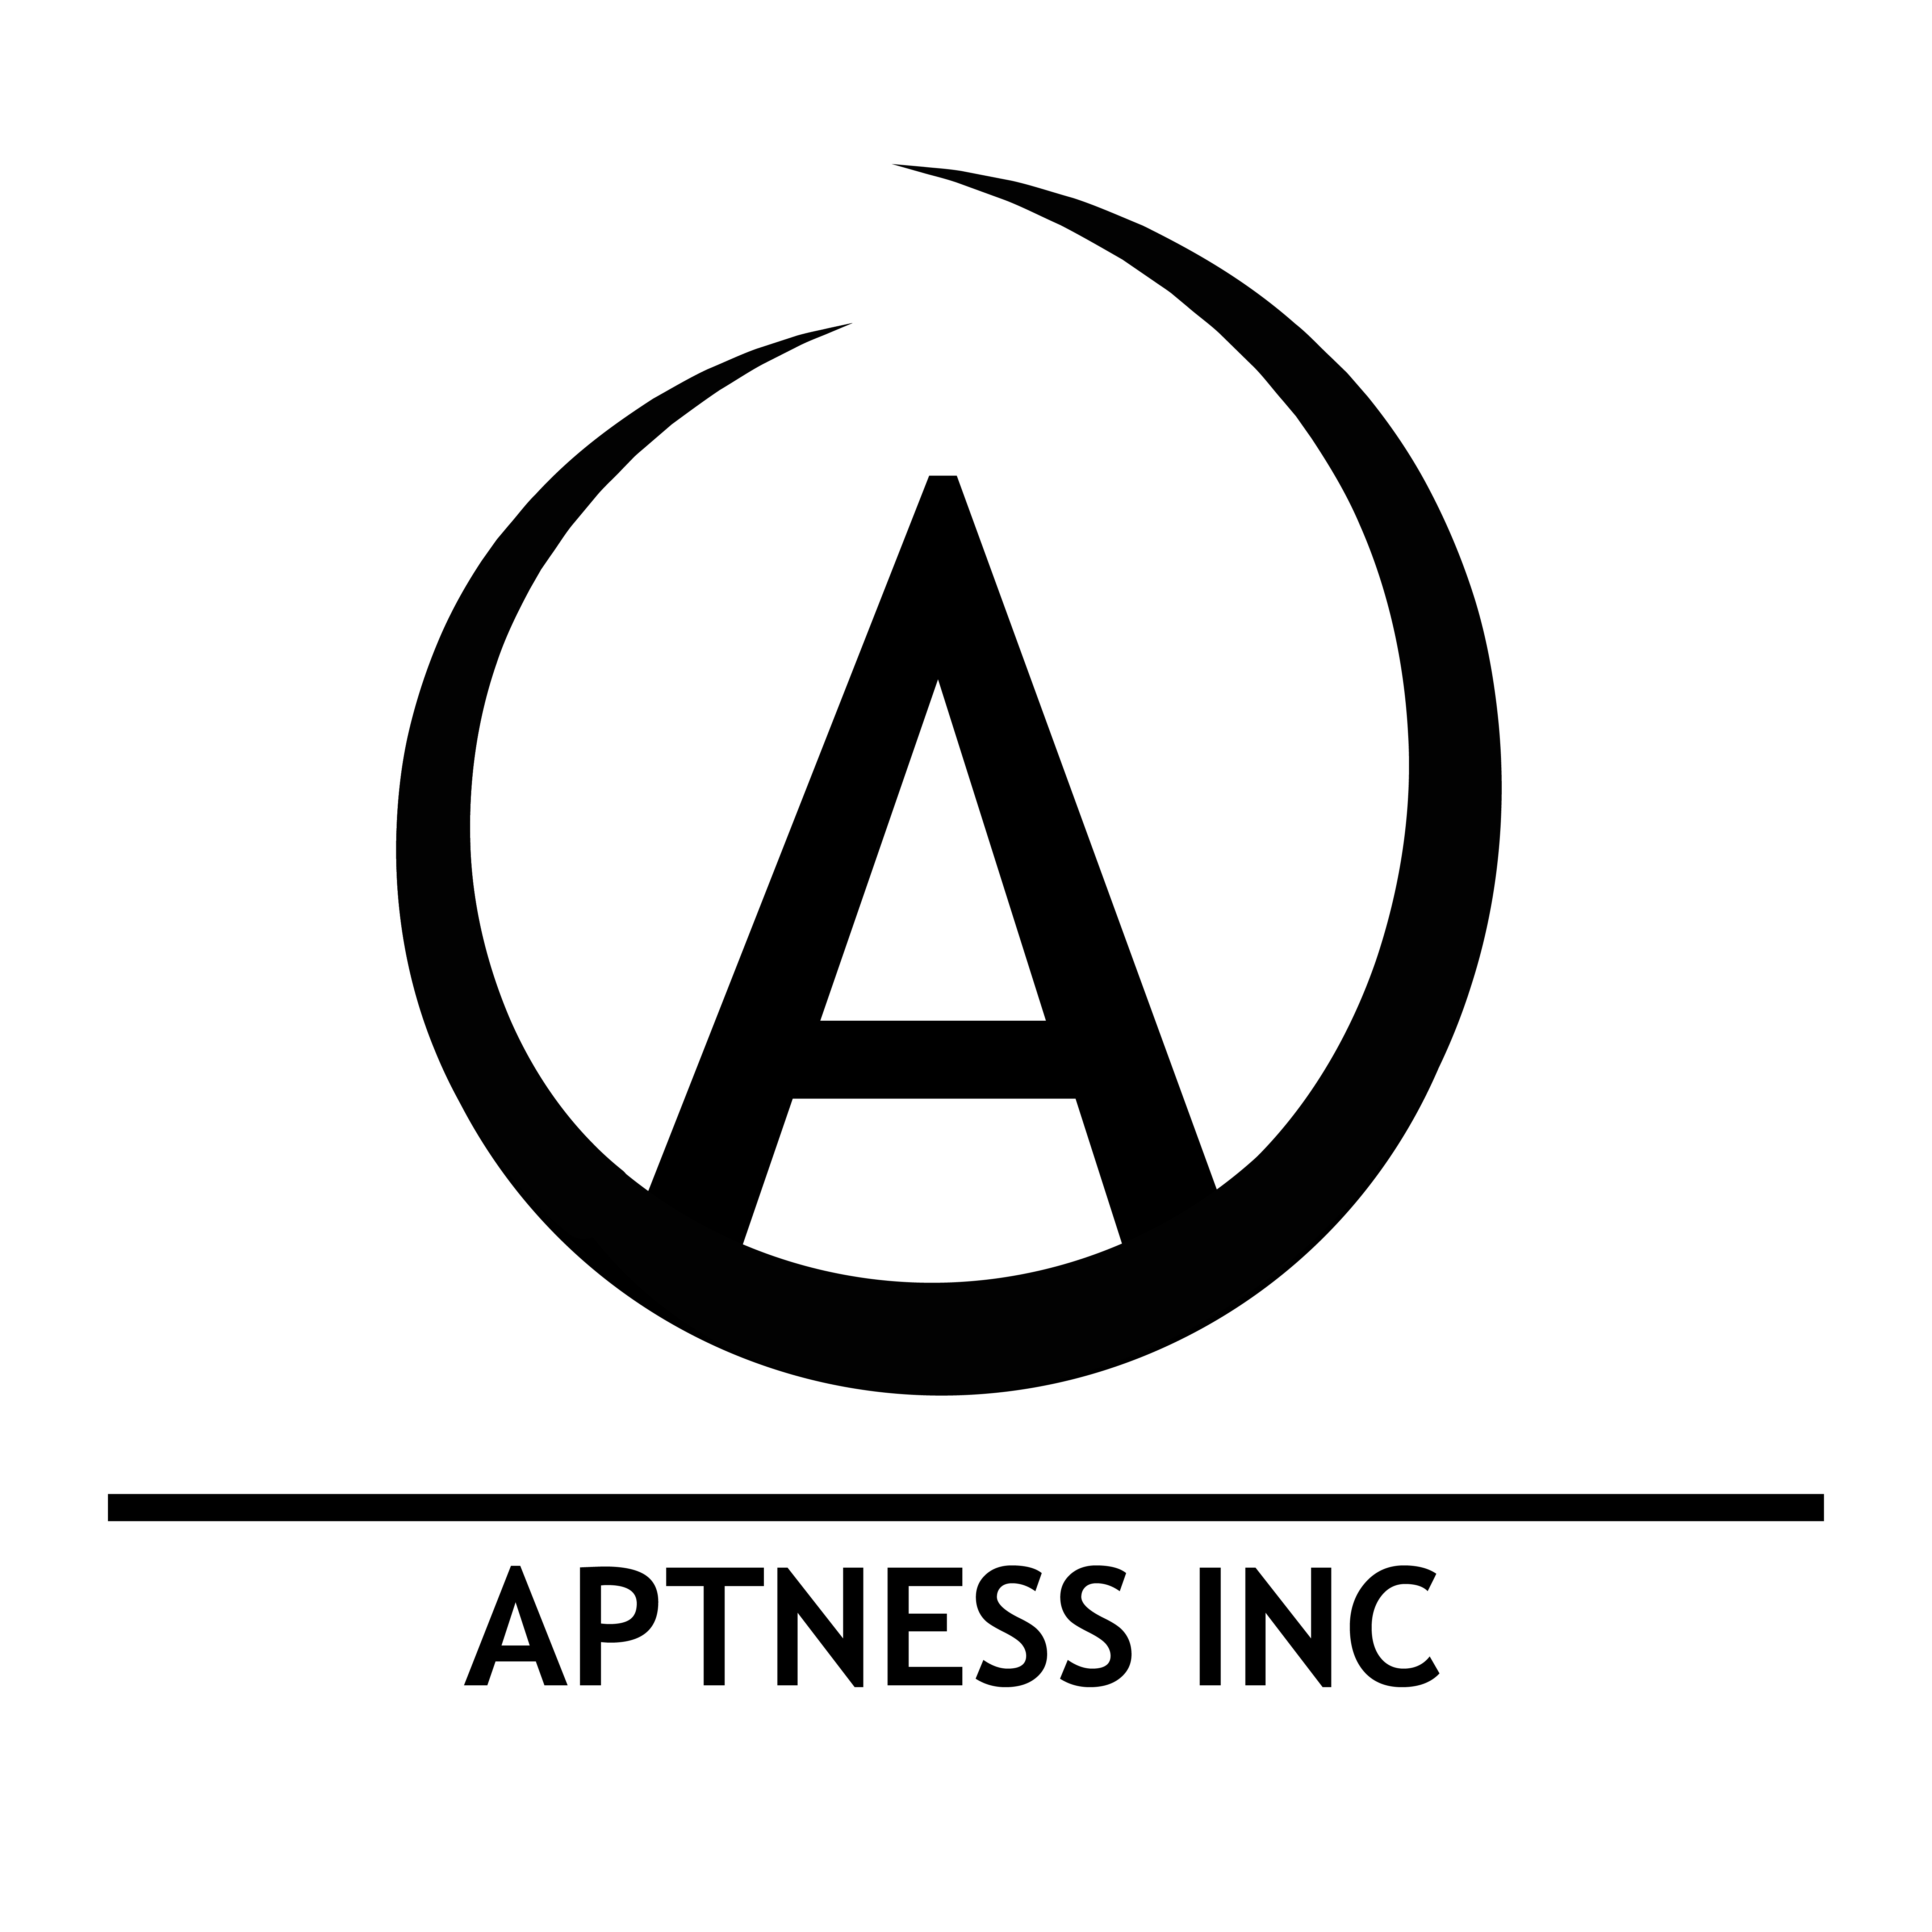
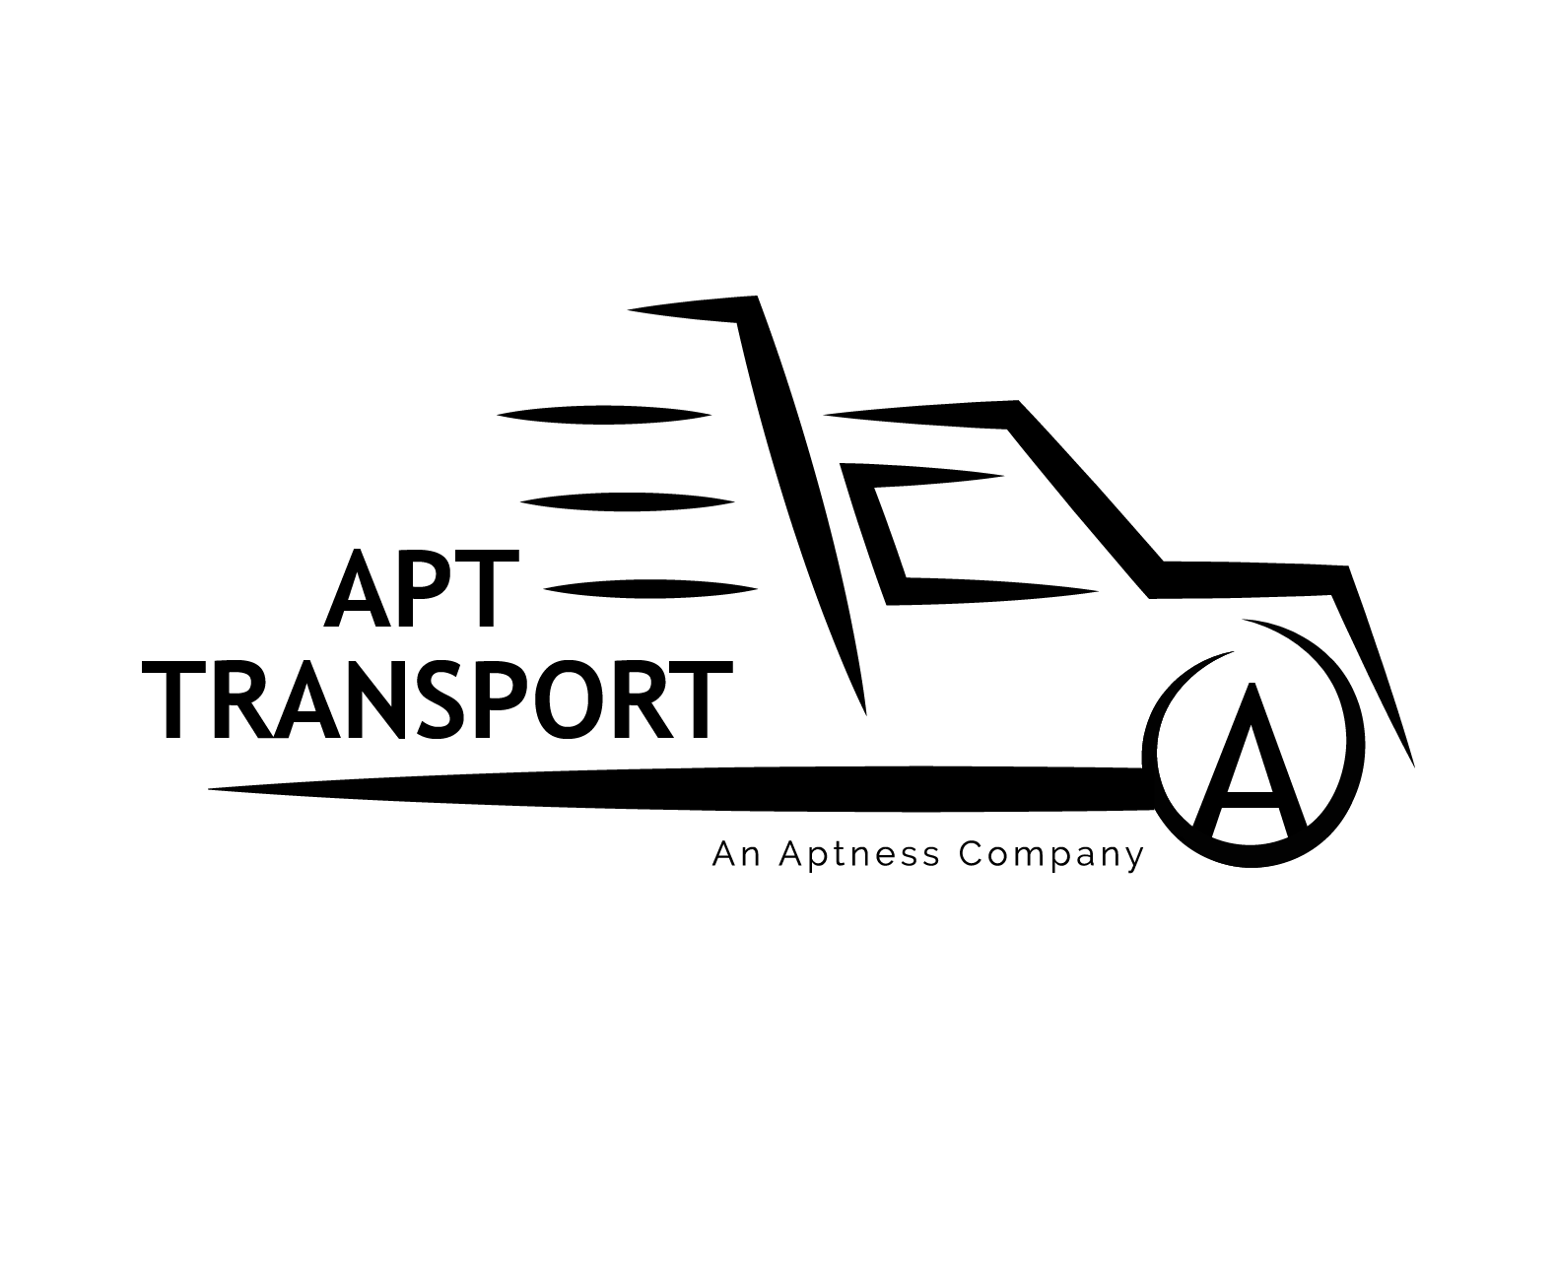



Aptness organization

Slide 8

Research Question
Main research question:
Is Apt Fitting profitable enough to expand its operations to serve other clients, and if so, what are the critical financial and operational indicators that support or limit this expansion?
Supporting Sub-questions:
What trends in revenue and costs are visible in Shop Monkey and Monday data?
Which performance indicators show growth potential or operational bottlenecks?
Are there enough resources to support increased demand from potential new clients?
This Photo by Unknown Author is licensed under CC BY-SA-NC

Slide 9
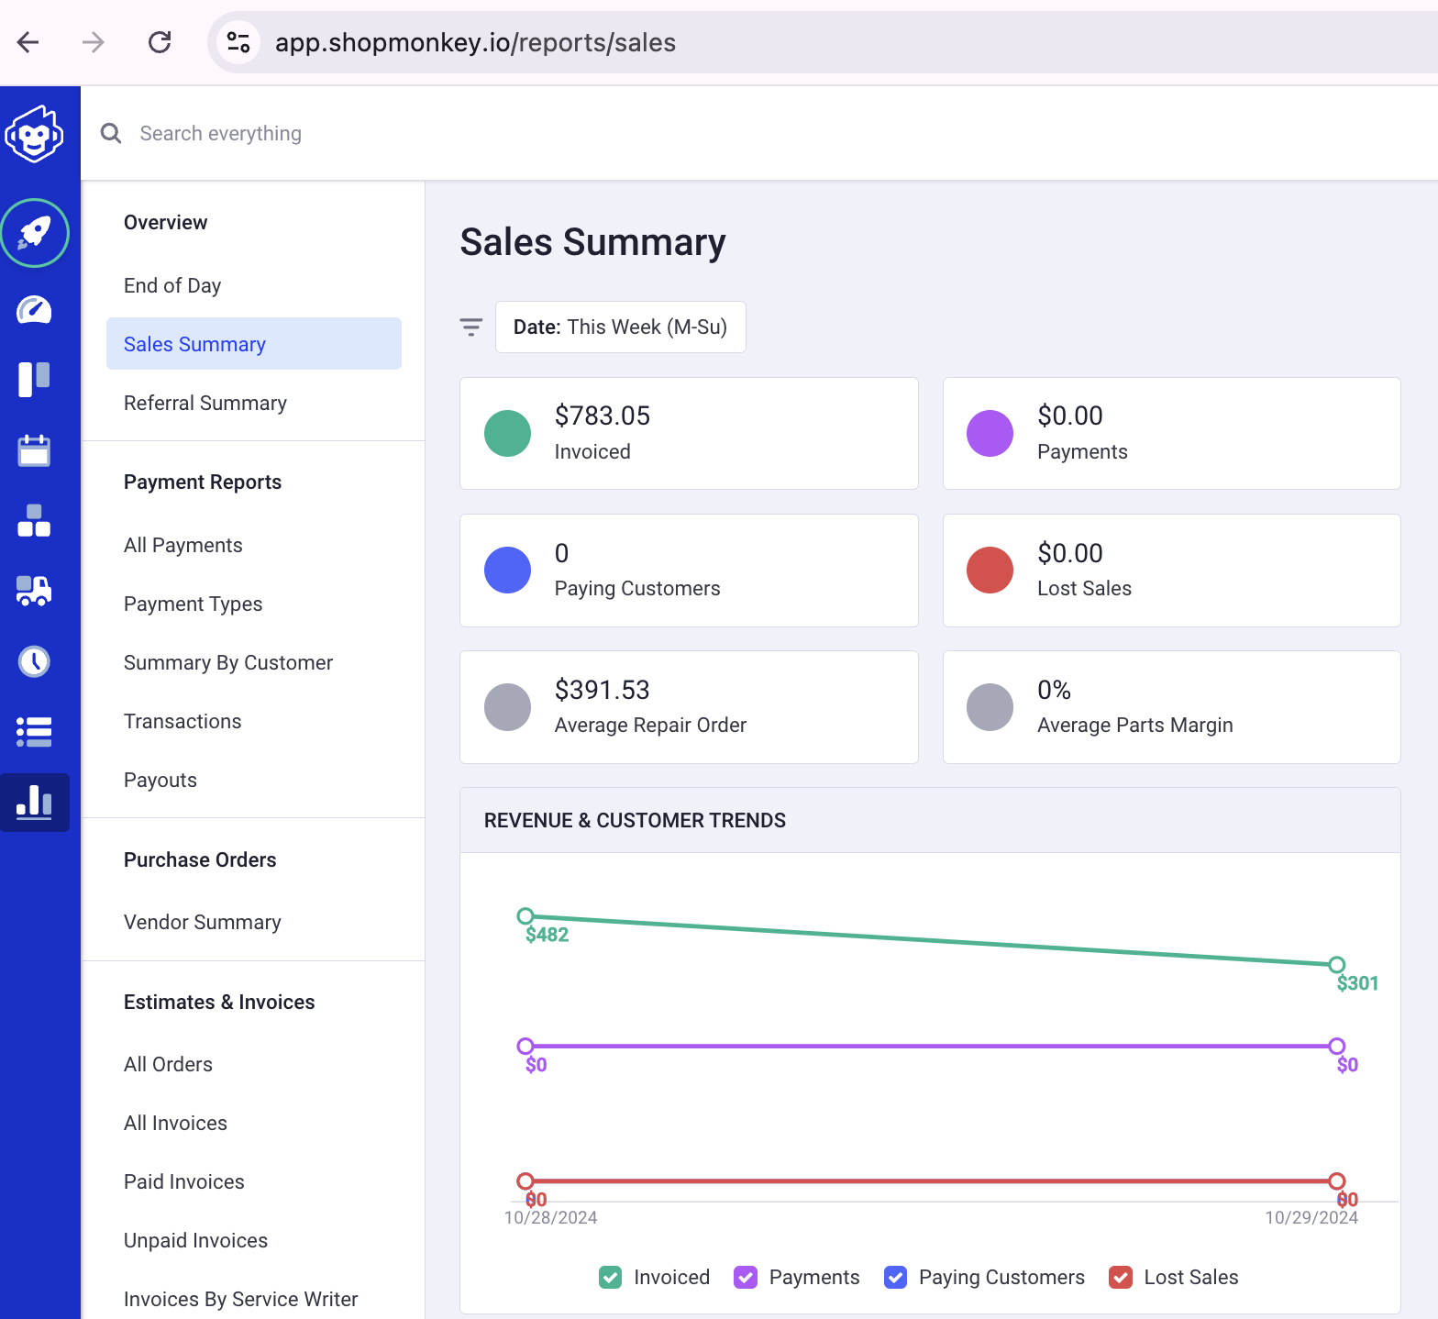
Data Sources and Description
Shop Monkey: Contains records of vehicle customizations, labor, parts, and material expenses.
Data collection from Shop Monkey and Quick Books
Data Analysis Preparation
Data Cleaning and Preprocessing

Slide 10
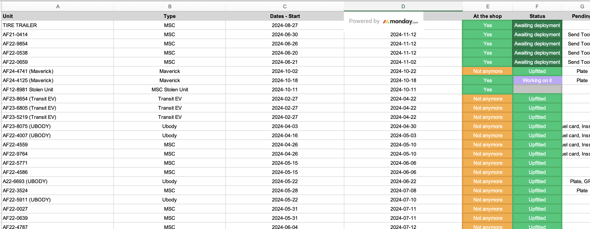
Data Sources and Description
Monday: is a project management tool that tracks tasks, deadlines, and team workflows. It organizes data in customizable boards, with export options for analysis.
Notes:
I am not longer using QuickBooks since I have all that information in Shop Monkey. I am using now also another data file from Monday.

Slide 11
Proposed methodology
Data Extraction and Cleaning: Steps to collect and preprocess data from Shop Monkey and Monday.
Profitability Analysis: Calculations of revenue vs. expenses per project, identifying major cost drivers.
Expansion Feasibility: Simulate additional customer scenarios and measure financial impact on operations.

Slide 12
Project Timeline
Data Collection and Cleaning - [11/08/2024]
Initial Analysis of Profitability - [11/15/2024]
Scenario Simulation for New Clients - [11/22/2024]
Report on Feasibility and Recommendations - [12/06/2024]

Slide 13
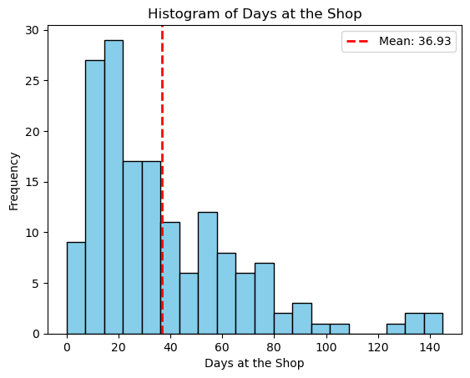
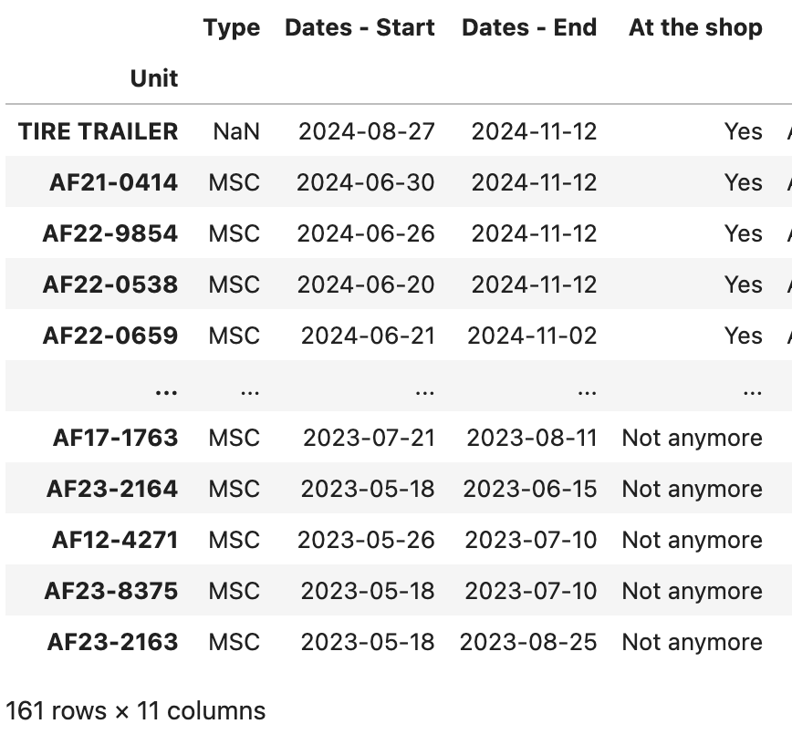
MONDAY Data
Add Work Start Date and Work End Date Columns: These will record when work on each unit begins and finishes.
Trace Efficiency: Measure the actual time spent on upfitting and validate claims of faster turnaround compared to competitors.
Client Solutions: Identify delays unrelated to work (e.g., awaiting client instructions) and propose tailored solutions.

Slide 14
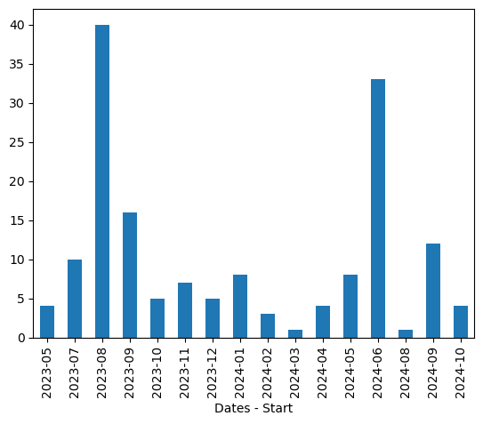
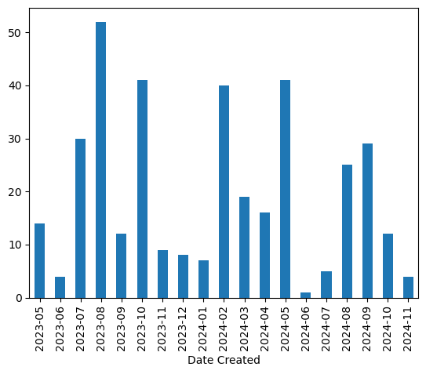
Total units per month
MONDAY
SHOP MONKEY

Slide 15
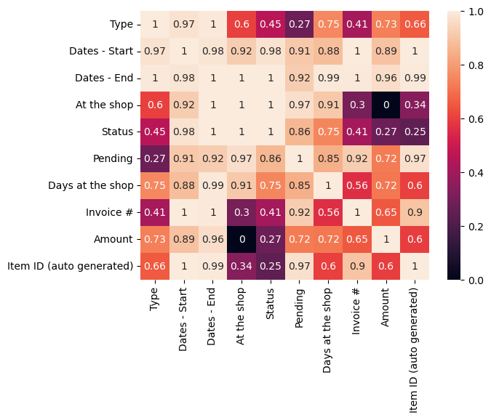
Heatmap Analysis Highlights
Days at the Shop vs. Amount Charged:
Correlation: Strong positive correlation (0.72).
Insight: Longer shop stays often align with higher charges but are influenced by parts, labor, and delays from customers (e.g., lacking delivery location).
Conclusion: Longer durations may reflect more extensive work, not necessarily higher charges due to time alone.
Type of Work vs. Amount Charged:
Correlation: Moderate positive correlation (0.75).
Insight: Certain types of work are linked to higher charges, likely due to complexity or resource needs.
Next Steps: Analyze average charges per type using numeric labels and visualize with boxplots or bar charts to refine pricing strategies.

Slide 16
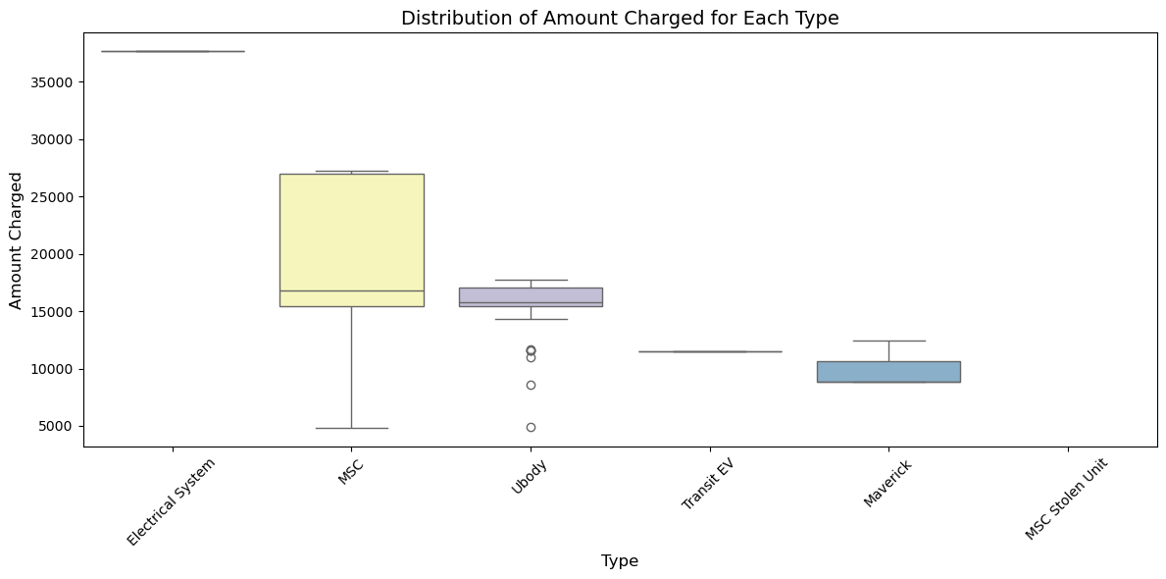
average charges per type
Electrical System has the highest average charge: $37,647.
MSC follows with an average of $17,859, reflecting a wide range of values given its large count.
Ubody averages at $15,419, showing slightly lower charges than MSC.
Transit EV and Maverick are smaller categories with average charges of 11,536and11,536and10,027, respectively.
Type MSC 106
Ubody 46
Maverick 3
Transit EV 3
MSC Stolen Unit 1
Electrical System 1
Notes:
Recomendations
Focus on High-Value Types: Leverage the profitability of Electrical System jobs by potentially expanding offerings in this category.
Improve Efficiency in Low-Value Jobs: Simplify or automate Transit EV and Maverick tasks to reduce costs and increase margins.

Slide 17
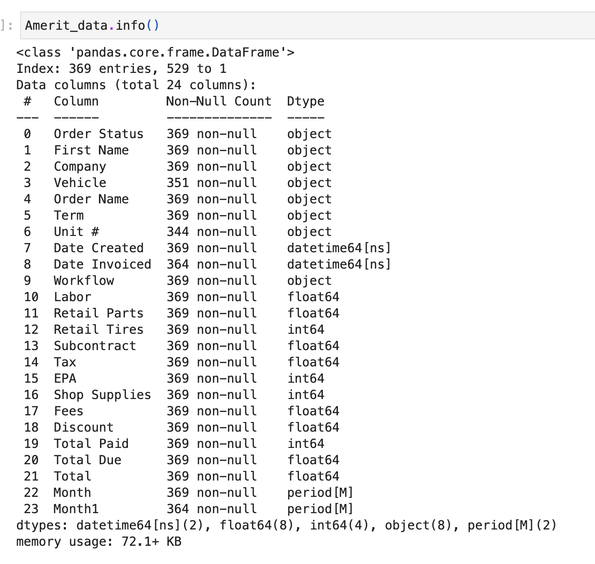
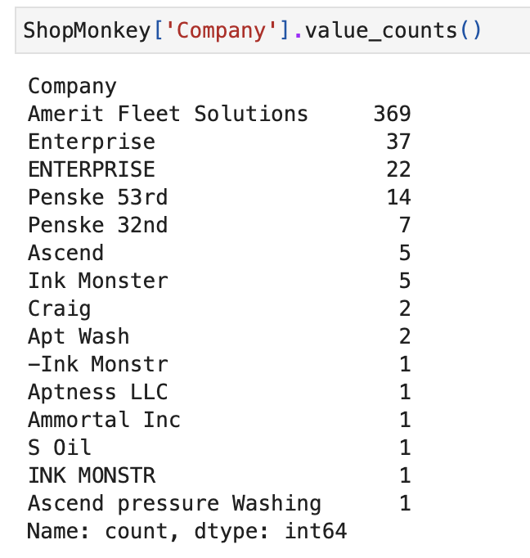
Shop monkey data
471 entries

Slide 18
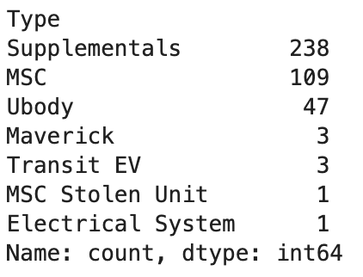
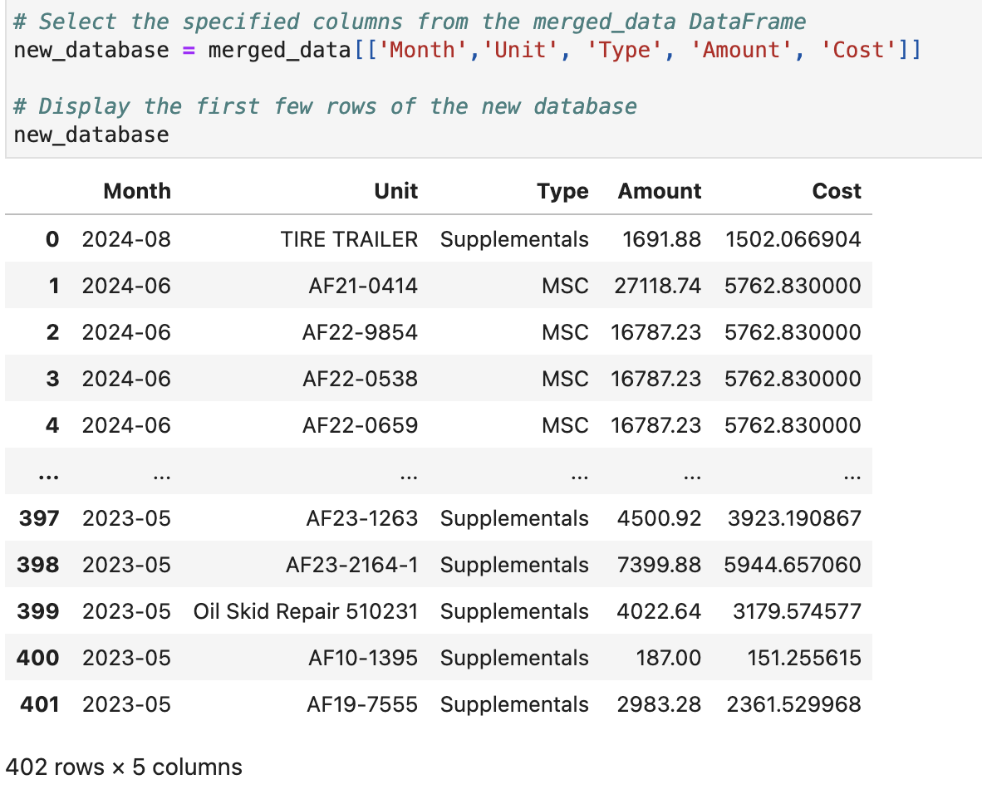
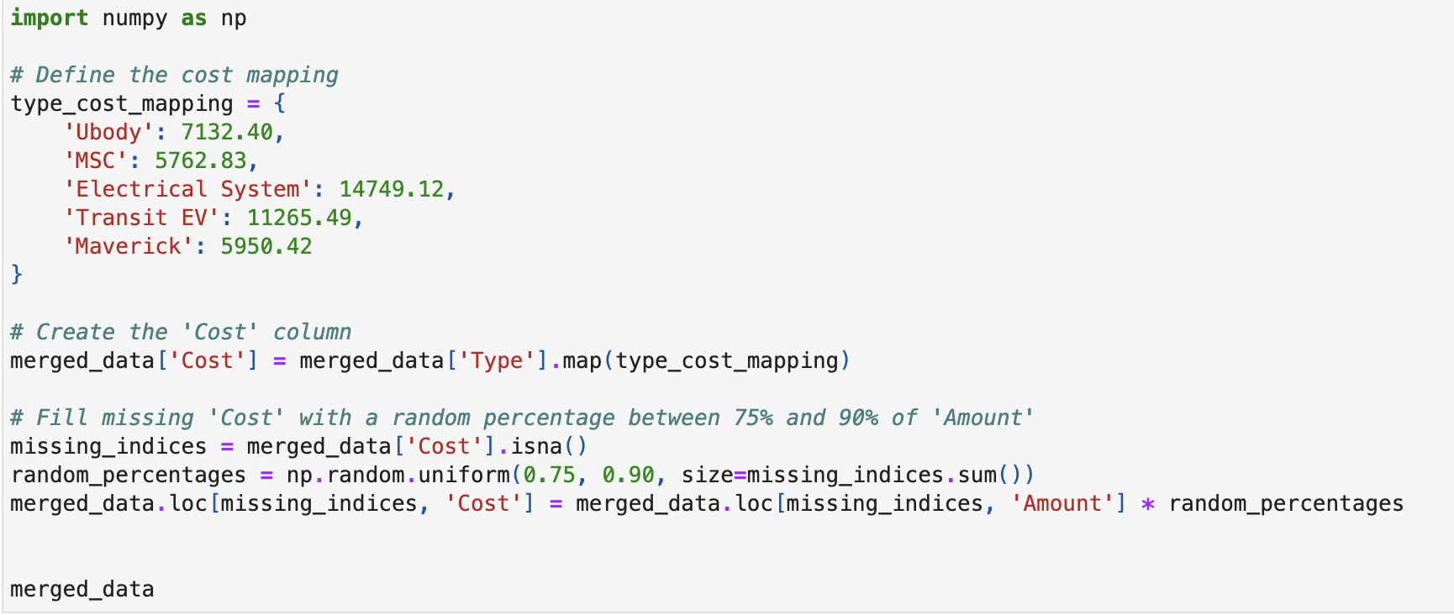
MERGING BOTH DATABASES
CLEANING DATA
Combine the Month_x and Month_y into a single column called Month.
Combine 'Total' and 'Amount' into a single column 'Amount’
Create the 'Cost' column
Replace missing values in the 'Type' column with 'Supplementals'

Slide 19
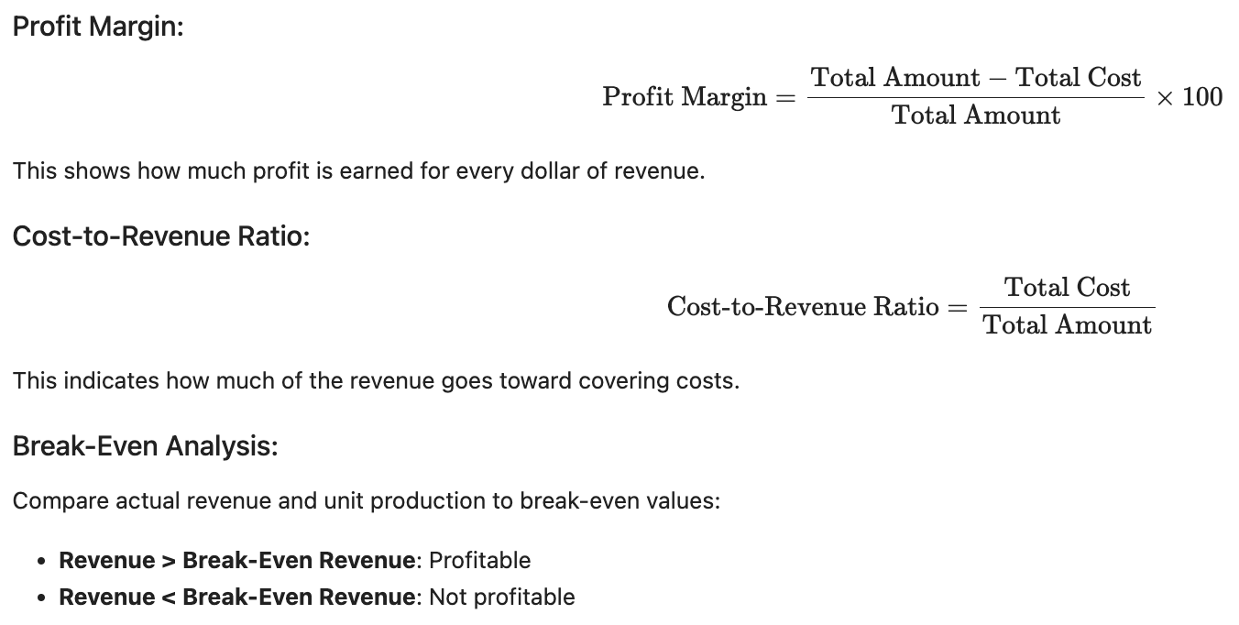
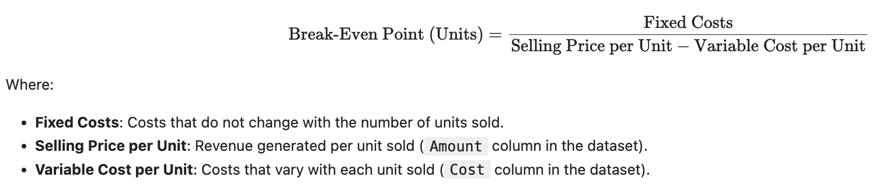
Profitability analysis
Step 1: Calculate Break-Even
Establish how many units need to be Upfit to break even.
Step 2: Ratio Analysis
Combines the use of margin ratios and returns ratios.
LINK: https://www.datarails.com/profitability-analysis-guide/

Slide 20
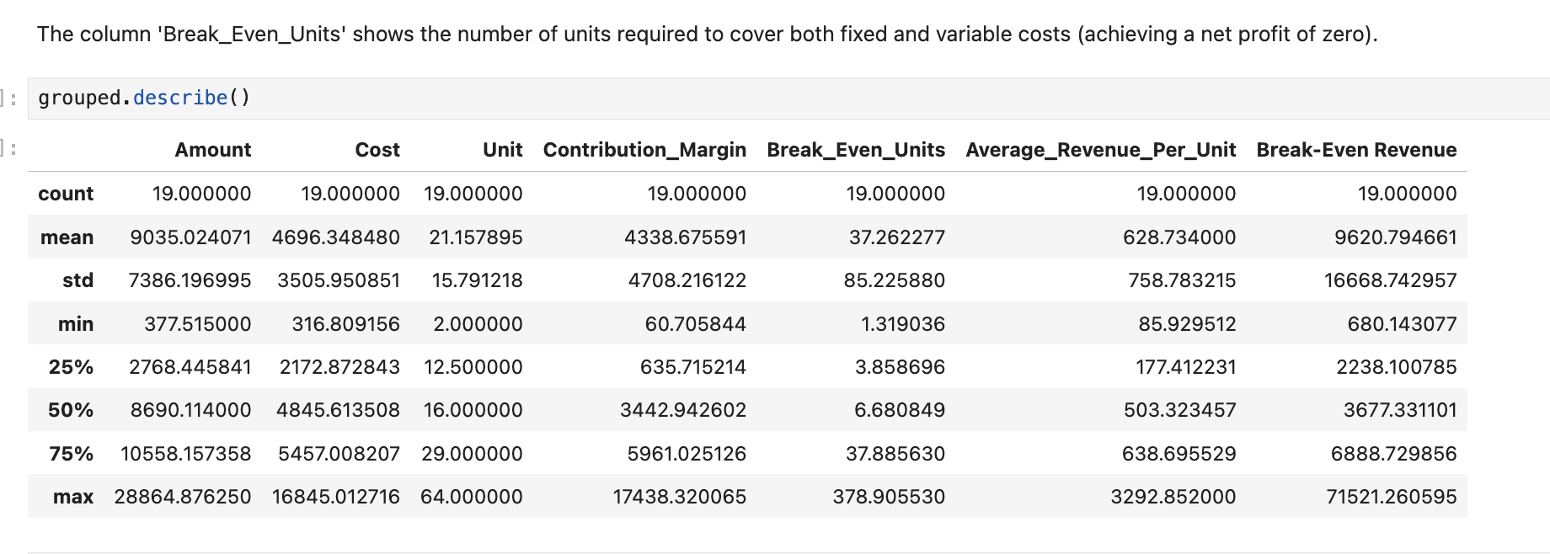
Break even analysis
The high standard deviation indicates significant differences in revenue across months.
This suggests fluctuating customer demand or seasonal trends affecting revenue.
The variability in ‘Unit’ reflects fluctuating demand
Contribution margin variability indicates inconsistent cost structures or pricing strategies.
Months with low unit sales are unlikely to meet the break-even point, signaling profitability challenges.
Wide variability underscores the need for better cost control and revenue alignment.

Slide 21
1. High Variability in Performance:
The significant fluctuations in revenue, costs, and contribution margins point to inconsistencies in operations, pricing, and demand.
The variability in the number of units produced each month further explains how some months experience lower revenue.
A potential solution to mitigate this variability would be securing additional clients or diversifying the customer base, which could help cover slower months and smooth out revenue fluctuations.
2. Cost Management:
Focusing on reducing costs can lower break-even thresholds, making profitability more attainable, especially during low-production months.

Slide 22
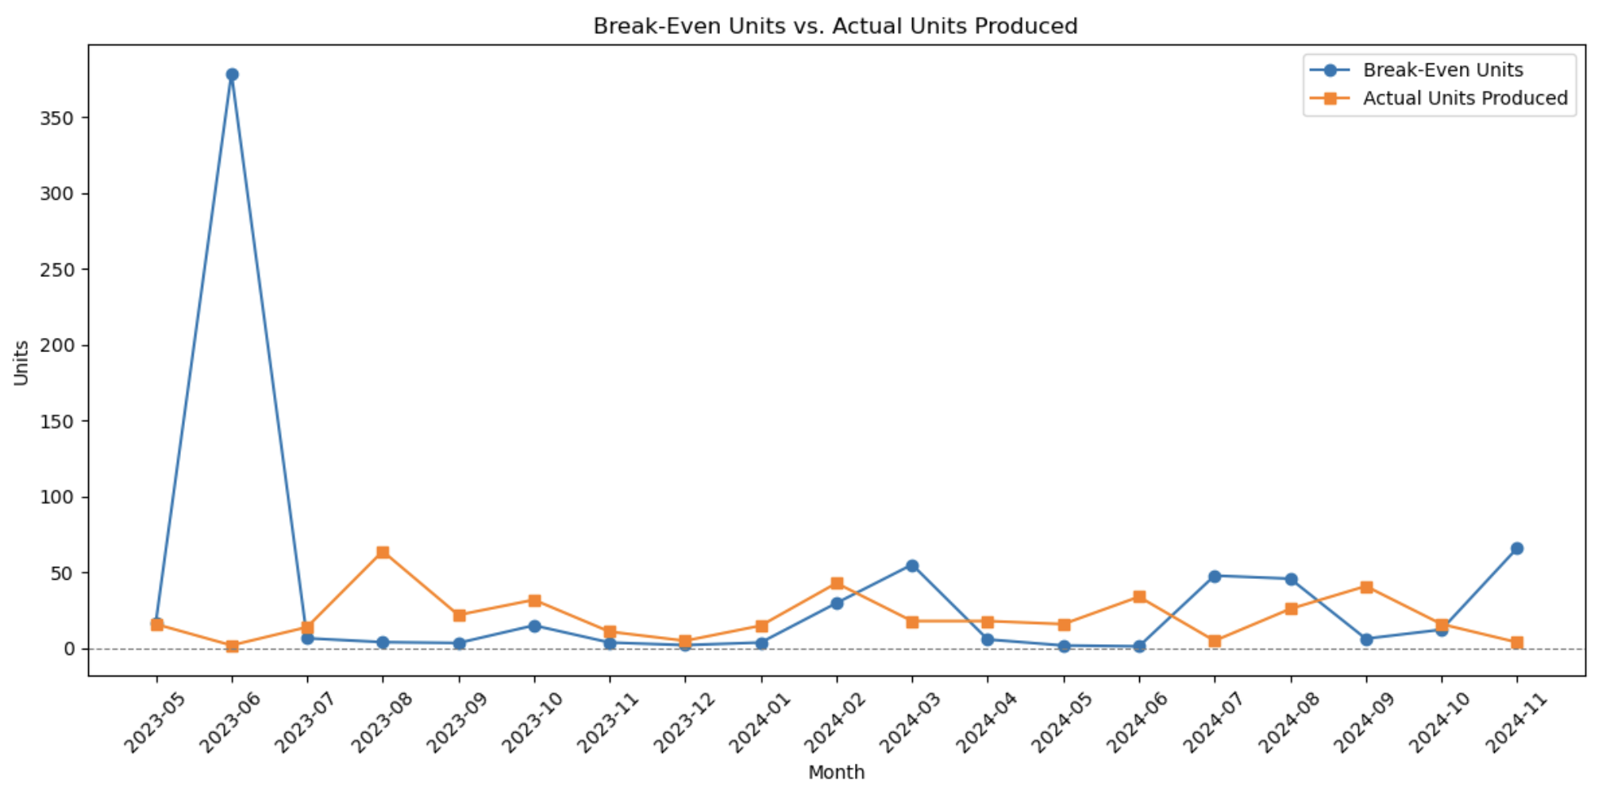
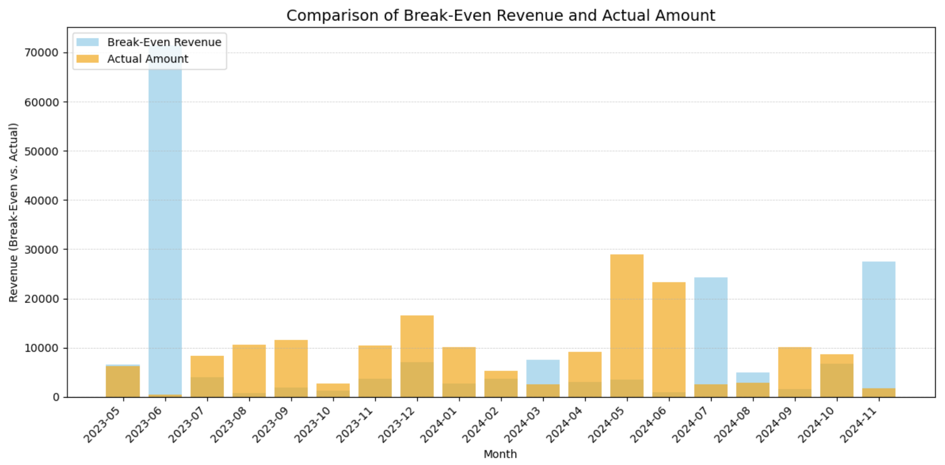
Comparison of Break even and Actual data
The actual units (orange) frequently exceed the break-even units (blue) in several months, suggesting that the company is producing more units than the minimum required to cover its fixed and variable costs.
In several months, actual revenue either approaches or exceeds the break-even point, reflecting strong financial performance.
However, exceptions such as June 2023 (4 units) and July 2024 (5 units) highlight months where break-even revenue spiked dramatically while actual revenue remained low.
To ensure consistent revenue generation, the company should address inefficiencies during high-workload months, investigate cost management practices in low-revenue periods, and focus on boosting job intake during quieter months. By aligning workload planning with operational strategies, the company can achieve greater financial stability and performance consistency.

Slide 23
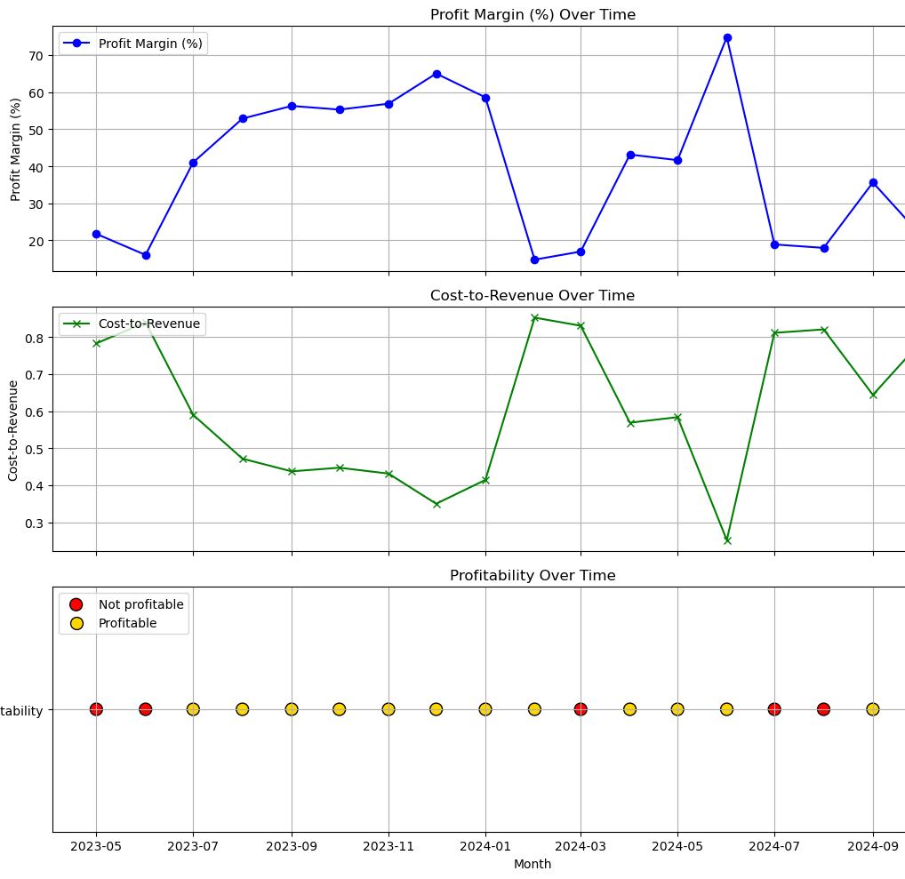
Profitability analysis
Profit Margin (%) Over Time
Significant fluctuations with peak margins in some months but inconsistent sustainability.
Variations suggest seasonality, fluctuating demand, or operational inefficiencies (e.g., low demand at year-end).
Cost-to-Revenue Over Time
Lower cost-to-revenue ratios align with higher profit margins, reflecting operational efficiency.
Higher ratios indicate increased costs, reducing profitability.
Profitability Over Time
Months are classified as profitable (yellow) or not (red).
Both 2023 and 2024 show overall profitability despite recurring losses in some months.
Conclusion
Cost-to-revenue ratio strongly influences profit margins and profitability.
Reliance on Amerit creates risk during slow periods.
Expanding the client base would stabilize revenue, reduce risks, and support growth.

Slide 24
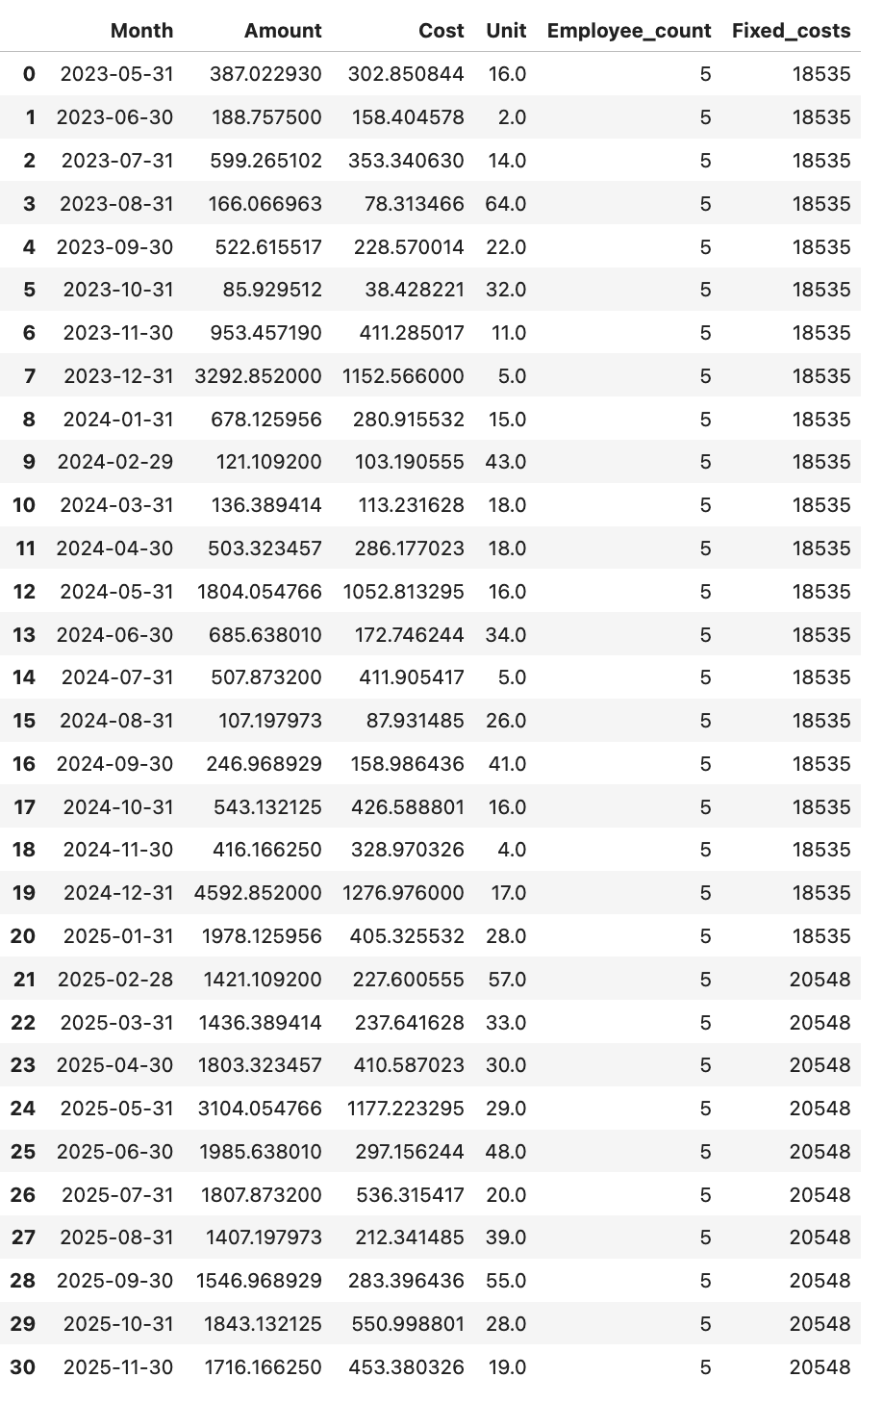
Machine learning
I will use Machine Learning (ML) to predict outcomes based on the existing data and estimate what the company needs to do when expanding to a new client.
Potential client for Apt Fitting, which would be Enterprise with recon units, the specific recon services will be:
DE ID
Painting of the wheels
Painting of the gate and platform
Painting of the steps
Detail
The data to have in mind is:
Units per month: 12 - 15 (or an average of 13.5)
Amount per unit: $1,300
Cost per unit: $124.41

Slide 25
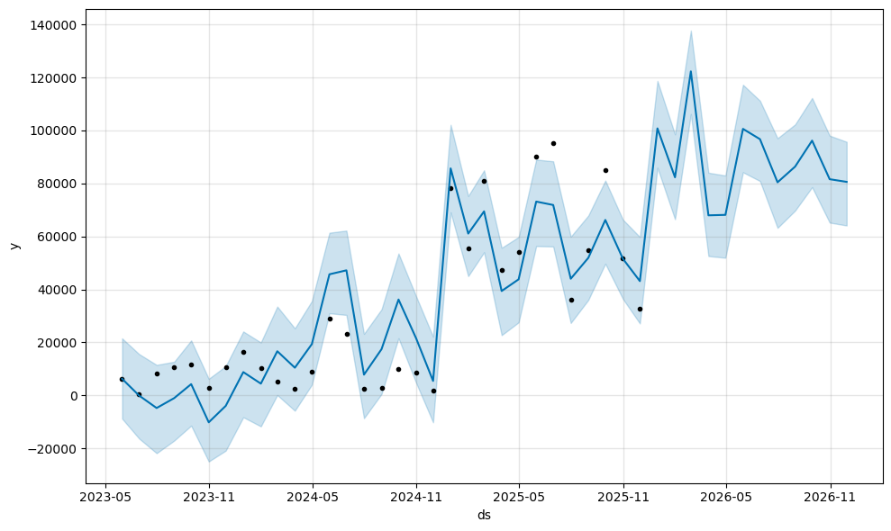
Time Series Forecasting
Using Prophet (a library for time series forecasting), predict future revenues and costs.
The time series graphic shows an upward revenue trend with fluctuations due to seasonal demand.
Historical data up to November 2024 reflects operations with one client.
From December 2024, adding a second client significantly boosts revenue, suggesting potential for profitable expansion.
However, seasonal dips remain, and confidence intervals widen in the long-term forecast, highlighting uncertainty.
The second client reduces dependency on one revenue source, improving scalability, but careful planning is needed to manage capacity during peak demand and downturns.

Slide 26
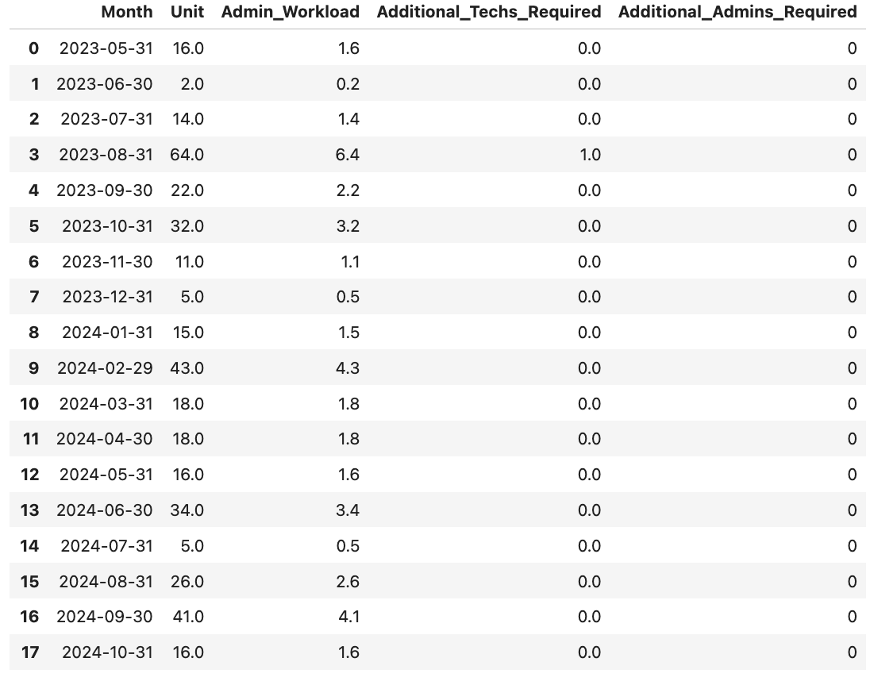
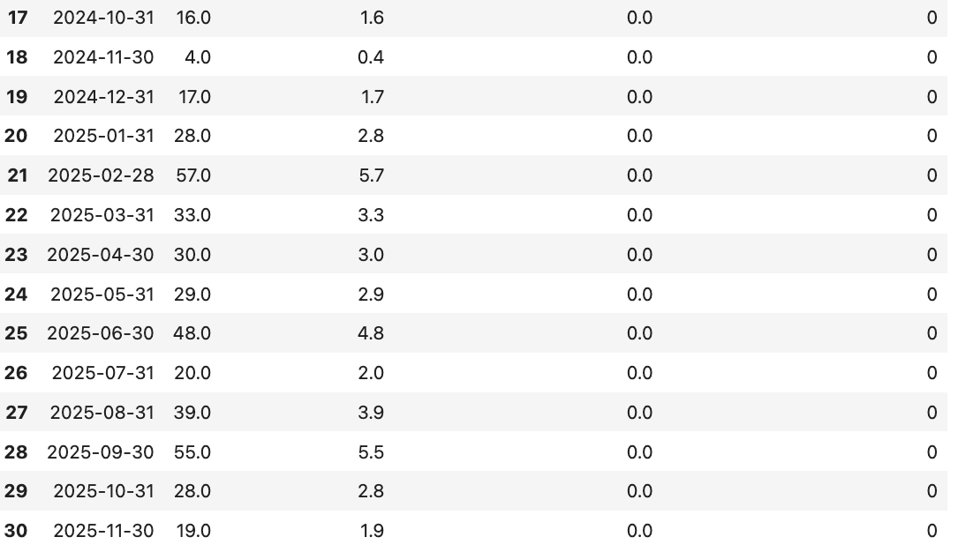
Estimate the number of additional administrative staff and technicians
No immediate hiring is necessary. The existing capacity is sufficient for the workload projected through 2025.

Slide 27
Key Findings Summary
Profitability:
Inconsistent profit margins due to seasonal trends and operational inefficiencies.
MSC services are the main revenue driver, while Supplementals and Ubody services offer moderate profitability.
MSC is the most efficient service, with lower break-even points compared to others.
Operational Trends:
High variability in monthly revenue, costs, and margins, influenced by seasonal demand.
Resource utilization is inconsistent, with high costs in some months reducing profitability.
Growth Potential:
Emerging services like Electrical Systems show diversification potential but require careful cost management.
Heavy reliance on Amerit limits scalability; expanding the client base could stabilize revenue and improve capacity utilization.
Research Question Insights:
Expansion Feasibility:
MSC services show profitability potential but require addressing operational inefficiencies.
Expanding the client portfolio and improving resource allocation are key to growth.
Key Focus Areas:
Stabilize revenue and reduce variability.
Improve efficiency of Supplementals and expand the client base.
Enhance operational planning and efficiency tracking to scale effectively.
Recommendation for Further Analysis:
Have a record of how many time each technician or the team spend upfitting each type of units to better have an analysis of times and estimation the number of staff members needed for the future.

Slide 28

Thanks

